Slide 1
LANGUAGE REVITALIZATION AND ALASKA NATIVE LANGUAGES
LAWRENCE KAPLAN, DIRECTOR
ALASKA NATIVE LANGUAGE CENTER
UNIVERSITY OF ALASKA FAIRBANKS
MAY 7, 2012
Notes:
Overview of what LR is and what it involves. There is of course much more to say than I can say here. So we have a bibliography of readings in the areas of LR and Language Teaching.
List of programs in packet – incomplete, fill out form.

Slide 2
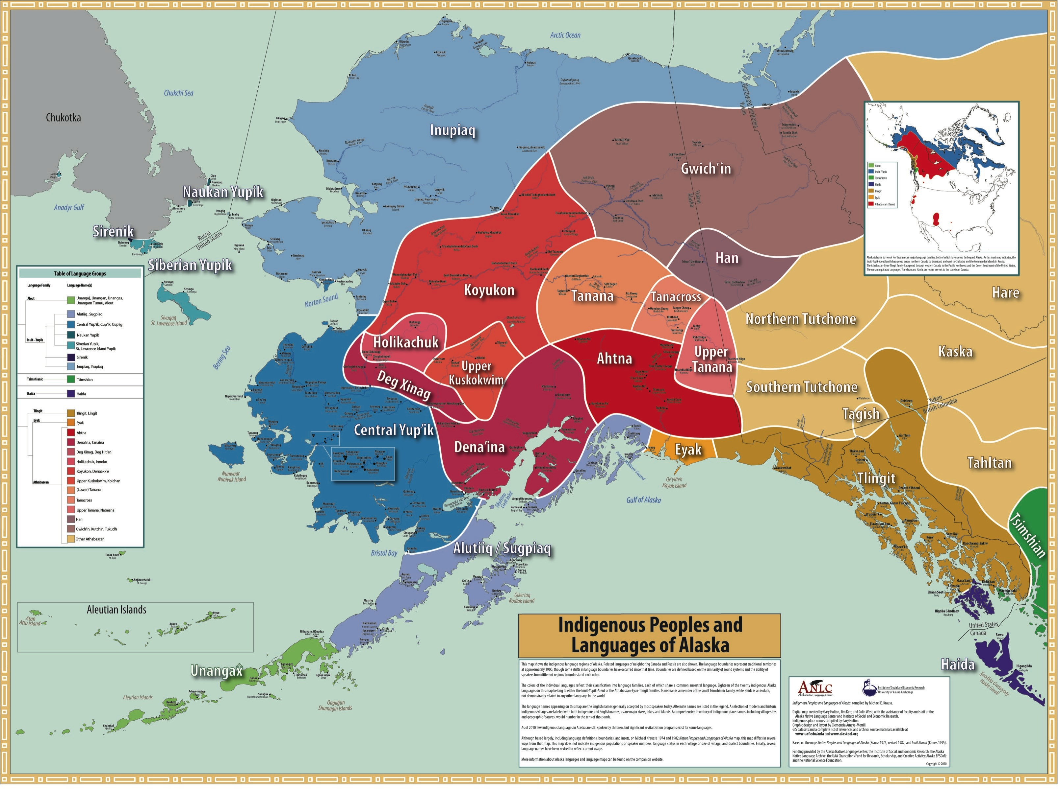
Notes:
New ANL map w/Native place names.

Slide 3
WHY WE ARE HERE TODAY
NUMBERS OF NATIVE LANGUAGE SPEAKERS ARE DECLINING
ALASKANS ARE CONCERNED
SB 130 PRESENTS AN OPPORTUNITY TO ADDRESS THE PROBLEM AND SUPPORT NATIVE LANGUAGE EFFORTS

Slide 4
CAUSES OF LANGUAGE DECLINE
INCREASING NEED TO KNOW ENGLISH
HISTORICAL PUNISHMENT OF ANL SPEAKERS
FAILURE OF THE LARGER SOCIETY TO VALUE NATIVE LANGUAGES AND CULTURES
MISUNDERSTANDING OF THE VALUE OF BILINGUALISM, EVEN THOUGH MANY TALENTED ALASKANS ARE BILINGUAL
Notes:
Some of the many reasons.

Slide 5
ALASKA’S SPECIAL NEEDS
ALASKA HAS 20 NATIVE LANGUAGES WITH DIFFERENT NEEDS, GOALS, CULTURES, DIALECTS
ALL LANGUAGE SITUATIONS ARE DIFFERENT, BECAUSE OF DIFFERENT CULTURE, HISTORY, AND MANY OTHER FACTORS
LANGUAGE AREAS ARE CROSS-CUT BY POLITICAL REGIONS AND DIALECTS, MAKING FOR A COMPLEX PICTURE

Slide 6
LANGUAGE REVITALIZATION
PROGRAMS THAT ADDRESS COMMUNITY GOALS FOR LANGUAGE MAY INCLUDE …
language-teaching,
recording of speakers,
preparation of language materials,
work with Native songs,
other efforts that will help maintain the language for future generations

Slide 7
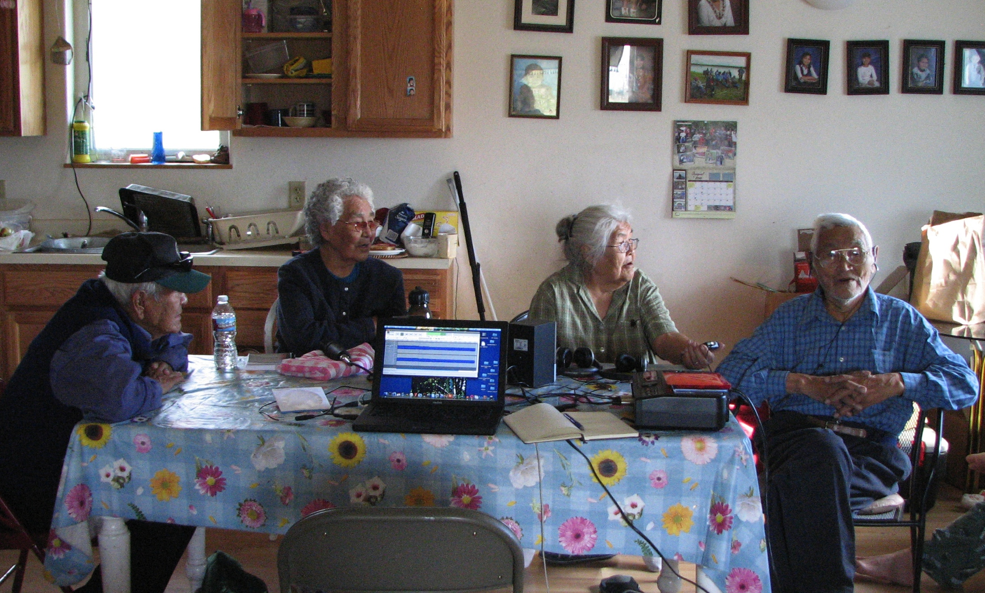
MINTO ATHABASCAN ELDERS DOCUMENTING SONGS

Slide 8
LANGUAGE SHIFT
WHEN A COMMUNITY OF PEOPLE CHANGES THEIR PRIMARY LANGUAGE
Example: a group that traditionally spoke a Native language now has English as its primary language.

Slide 9
LANGUAGE DOCUMENTATION
DOCUMENTATION RECORDS LANGUAGE
CREATES AND PRESERVES RECORDINGS OF LANGUAGE FOR FUTURE GENERATIONS
MAY BE WRITTEN MATERIALS, SOUND OR VIDEO RECORDINGS
MANY BELIEVE A LANGUAGE WILL NEVER DIE IF DOCUMENTED, SINCE IT CAN BE LEARNED AGAIN AND SPOKEN

Slide 10
Documentation serves language revitalization
DICTIONARIES (words)
GRAMMARS (forming sentences)
TEXTS (connected speech)
All serve as resources to create teaching materials.
Notes:
(WHICH EXPLAIN HOW A LANGUAGE WORKS, HOW TO MAKE CORRECT SENTENCES)
(PUBLISHED STORIES, ORAL HISTORY, NARRATIVES, OFTEN WITH TRANSLATION)

Slide 11
WHO DOCUMENTS LANGUAGES?
1. NATIVE ORGANIZATIONS
2. SCHOOLS AND SCHOOL DISTRICTS
3. UNIVERSITY DEPARTMENTS
4. INDIVIDUALS
5. RELIGIOUS ORGANIZATIONS
Notes:
MANY ORGANIZATIONS AND CLASSES PRODUCE THEIR OWN LEARNING MATERIALS

Slide 12
1. NATIVE LANGUAGE LEARNING AND TEACHING IN SCHOOLS
MANY NATIVE LANGUAGE PROGRAMS IN SCHOOLS STATEWIDE, VARY IN TIME ALLOTTED, APPROACHES
IMMERSION SCHOOLS OFFER INTENSIVE LANGUAGE
UNIVERSITY CLASSES AND DEGREE PROGRAMS
KUC/UAF IN BETHEL: YUP’IK MAJOR TAUGHT IN YUP’IK

Slide 13
2. LANGUAGE LEARNING AND TEACHING OUTSIDE OF SCHOOLS
LANGUAGE CLASSES TAUGHT BY OTHER ORGANIZATIONS
MENTOR-APPRENTICE LEARNING
SELF-DIRECTED STUDY
Notes:
(LIKE SEALASKA KUSTEEYI INSTITUTE, EYAK LANGUAGE LEARNING GROUP)
(WHERE A LEARNER IS PAIRED WITH A SPEAKER TO SPEND 10+ HOURS A WEEK ON THE LANGUAGE – Ben Young)

Slide 14
3. LANGUAGE COMMISSIONS AND COMMITTEES
ORGANIZATIONS FORMED TO DEFINE GOALS FOR LANGUAGE WORK ON ISSUES SUCH AS…
VOCABULARY “MODERNIZATION” (WORDS FOR NEW CULTURAL AND TECHNOLOGICAL ITEMS)
SIGNAGE IN NATIVE LANGUAGE
LANGUAGE ADVOCACY
PROMOTING NATIVE LANGUAGE PLACE NAMES
SPELLING AND DIALECT ISSUES
Notes:
Alutiiq New Words Committee, Gwich’in Language Committee, IHLC

Slide 15
4. OTHER EFFORTS INVOLVING LANGUAGE
DANCE GROUPS WITH NATIVE SONGS
ART CLASSES, CRAFTS
ETHNOBOTANY AND OTHER SCIENCE
CULTURE CAMPS
INDIVIDUALS LEARNING BY THEMSELVES
INDIVIDUALS MAKING TAPES OF ELDERS

Slide 16
WHO MAKES IT HAPPEN?
INDIVIDUALS CAN MAKE A HUGE DIFFERENCE, WHEN THEY GET INSPIRED AND MAKE A PERSONAL COMMITMENT
LANGUAGE REVITALIZATION IS A COMMUNITY-DRIVEN EFFORT FROM THE “GRASS ROOTS”. COMMUNITIES DEFINE GOALS AND DIRECT PROGRAMS.

Slide 17
U.S. Arctic Research Commission Recommendations 2011-12
www.arctic.gov/news/02-27-12.pdf
5. Assess Indigenous Languages, Identities, and Cultural Research Needs
USARC Recommendation: An integrated arctic indigenous languages research plan that: conducts regular assessments to understand the extent and diversity of languages spoken by arctic indigenous peoples and the viability of those languages for future generations; document procedures to ensure that languages and place names spoken and given by people are recorded and preserved; and defines policy options and processes for language monitoring and preservation.

Slide 18
PRINCIPAL QUESTIONS FOR LANGUAGE REVITALIZATION
WHAT PROGRAMS ARE THERE FOR YOUR LANGUAGE?
HAS YOUR LANGUAGE COMMUNITY SET GOALS?
WHAT WOULD YOU LIKE TO SEE ACCOMPLISHED?
WHO PARTICIPATES IN LANGUAGE REVITALIZATION?
WHAT TYPES OF EFFORTS ARE PRODUCTIVE?
WHAT RESOURCES ARE REQUIRED?
WHAT IS EFFECTIVE LANGUAGE TEACHING?
WHAT WOULD YOU LIKE THE NEW ANL ADVISORY COUNCIL TO DO?

Slide 19
FOSTERING INDIGENOUS LEADERSHIP IN LANGUAGE
UAF GRADUATE PROGRAMS HELPING TO EDUCATE INDIGENOUS SCHOLARS WITH KNOWLEDGE AND CREDENTIALS IN LANGUAGE AREAS
20 RECENT MASTERS DEGREES IN YUP’IK LANGUAGE EDUCATION AND RELATED AREAS
SEVERAL NEW PhDs, INCLUDING YUP’IK LANGUAGE AND CULTURE; ALUTIIQ LANGUAGE PLANNING

Slide 20
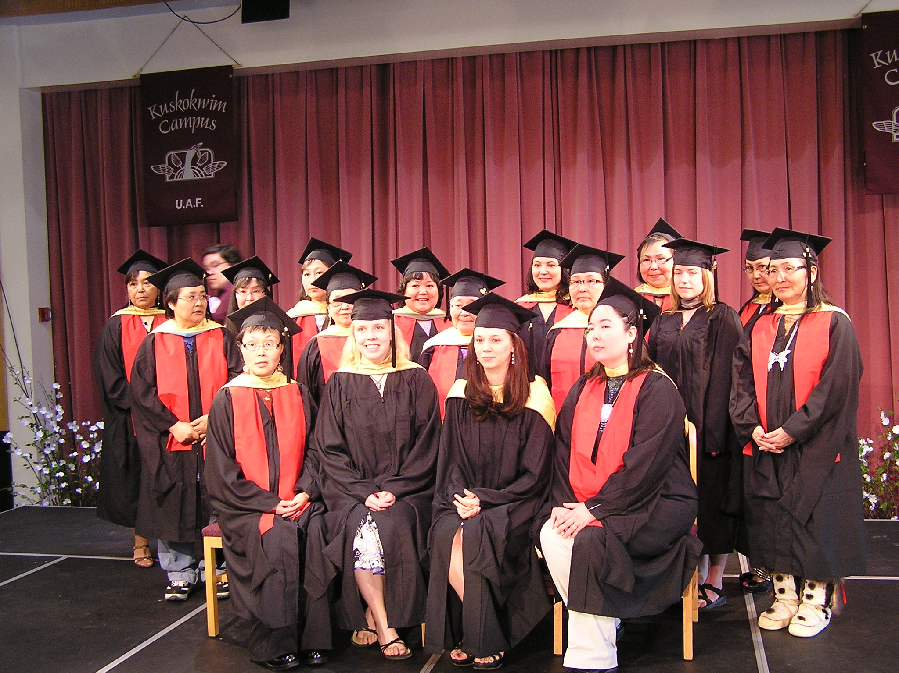
UAF’s KUSKOKWIM CAMPUS MASTERS DEGREE GRADUATES - 2010

Slide 21
THANK YOU
LIEUTENANT GOVERNOR MEAD TREADWELL
SENATOR OLSON AND SPONSORS OF SB130
BARBARA PROPES
LOREN PETERSON
ANLC FACULTY

