Slide 1
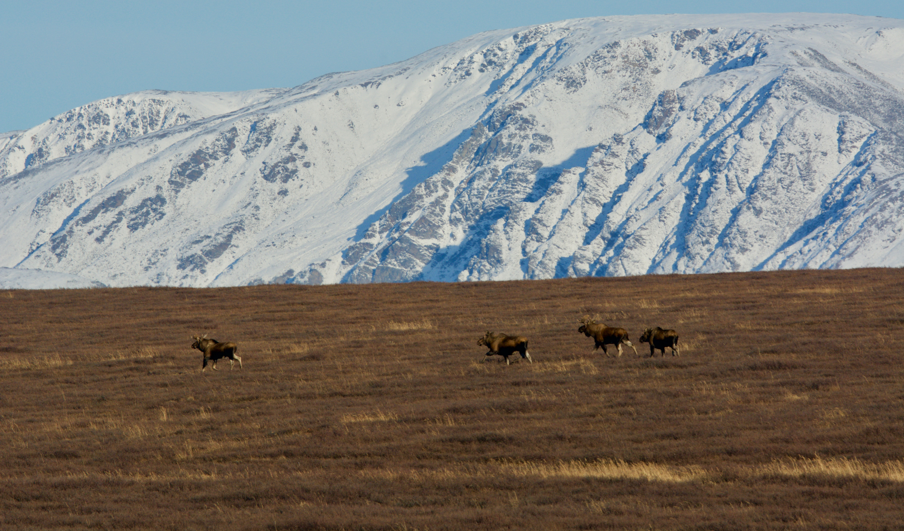
Environmental and Demographic drivers of a rapidly expanding moose population
V. Sebastian Zavoico, M.S.
PhD Student, University of Alaska, Fairbanks
Bristol Bay Campus Lunch and Learn
October 2023
This work takes place on ceded and unceded lands of the Yup’ik people of southwest Alaska

Slide 2
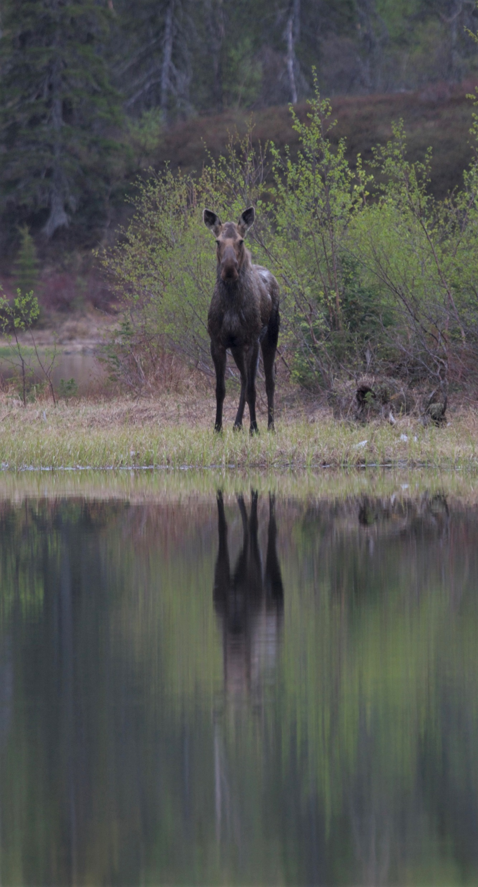
Outline
Introduction: population dynamics & moose in Togiak NWR
Methods
Results
Conclusions
Notes:
1 model – 2 parts that are interrelated
PC is me unless I note otherwise

Slide 3
Intro to Population Dynamics
N_{t}
N_{t} = Births + Immigration – Deaths – Emigration
$$λ_{t}=\frac{N_{t}}{N_{t−1}}$$

Slide 4
Intro to Population Dynamics
Fluctuations in the environment affect demographic rates, which affects λ_{t}
Birth
Immigration
Death
Emigration
λ_{t}
Understanding patterns of population dynamics can illuminate mechanisms behind population trajectories
Identifying which rates impact λ_{t} the most can increase conservation efficiency
Can also illuminate the mechanisms behind population expansion
Notes:
Not only important which demographic rates change lambda, but also how the environment affects the demographic rates, that then affects lambda.
Highlight which environmental factors affect which demographic rates, and the strength of each factor (as denoted by thickness of the arrow). And then how much changes in each demographic rate actually changes lambda. Where the arrows go, and how thick the arrows are, depend on the life history and demography of the population

Slide 5
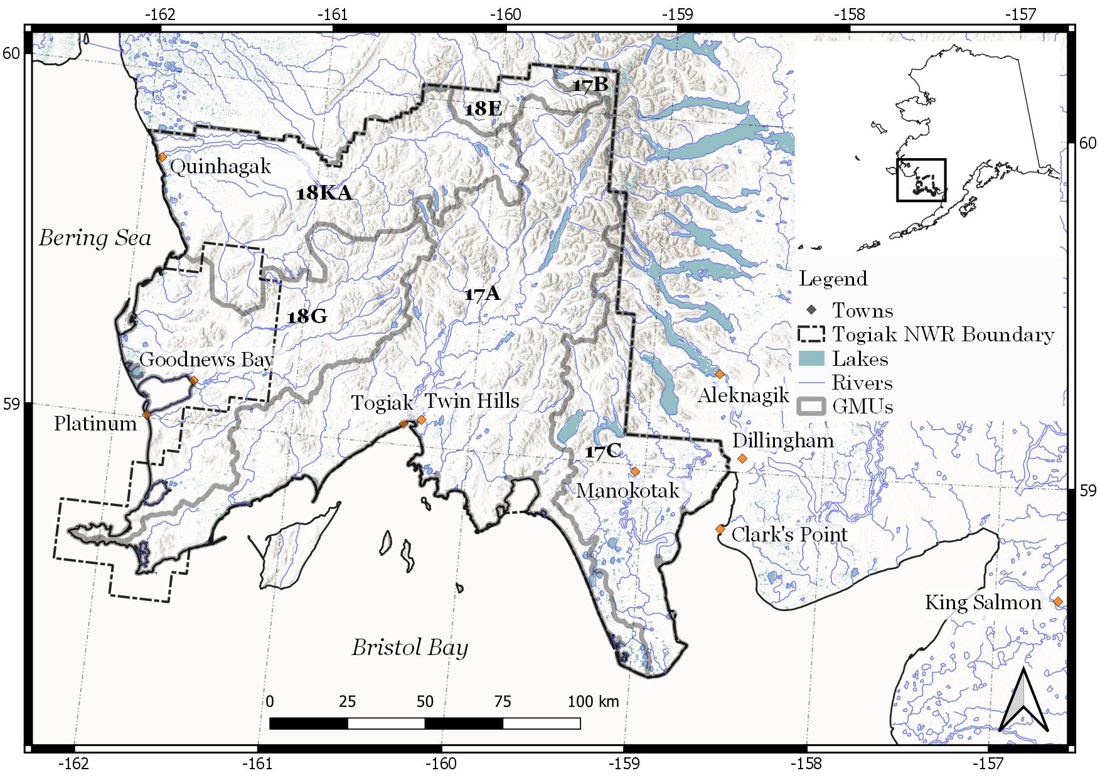
Orientation
Notes:
Establish that I mostly studied the moose in what is now the Refuge boundary, which entails most of the Togiak River, Goodnews River, and Kanektok River drainages, among other smaller rivers.

Slide 6
History of moose in Togiak NWR
Togiak has long been caribou country, with relatively few moose
Ivan Petroff, 1884:
No mention of moose!

Slide 7
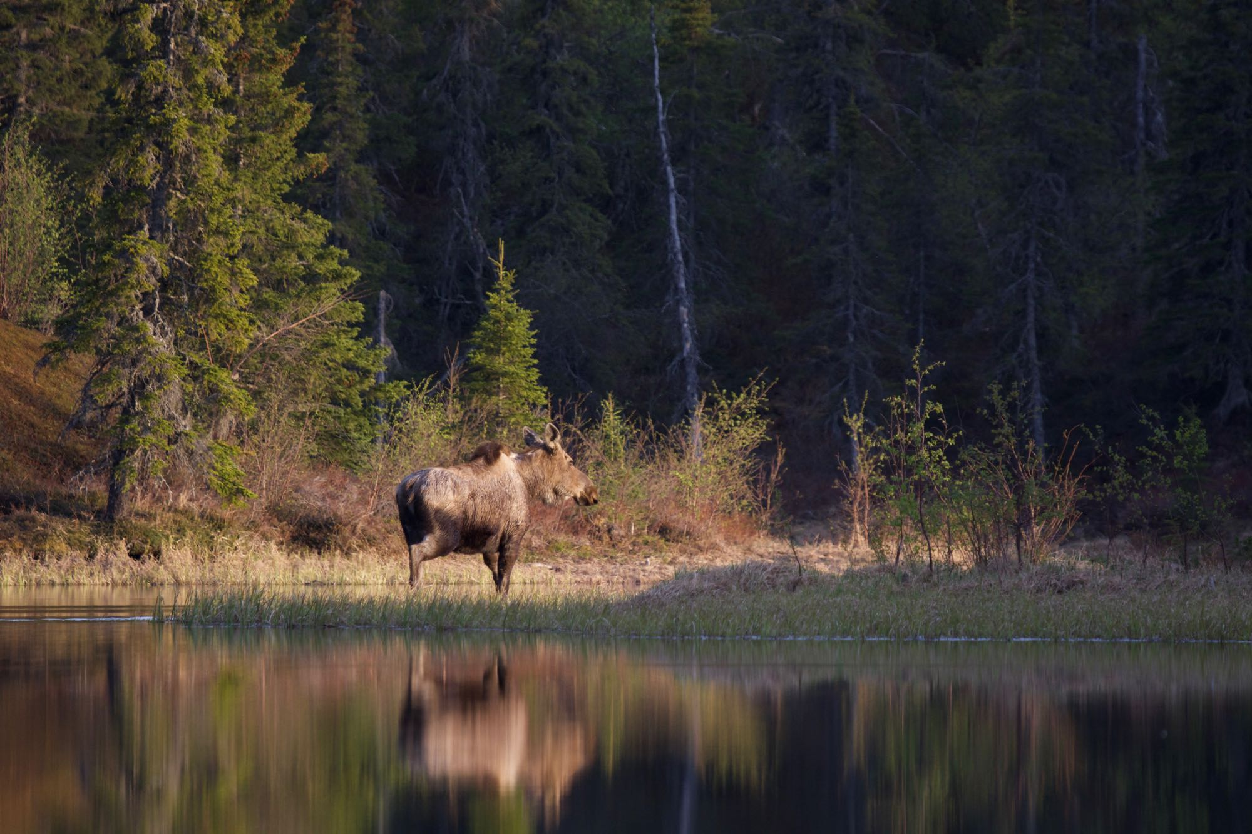
History cont’d
Kowta, 1964:
Jemison, 1994:

Slide 8
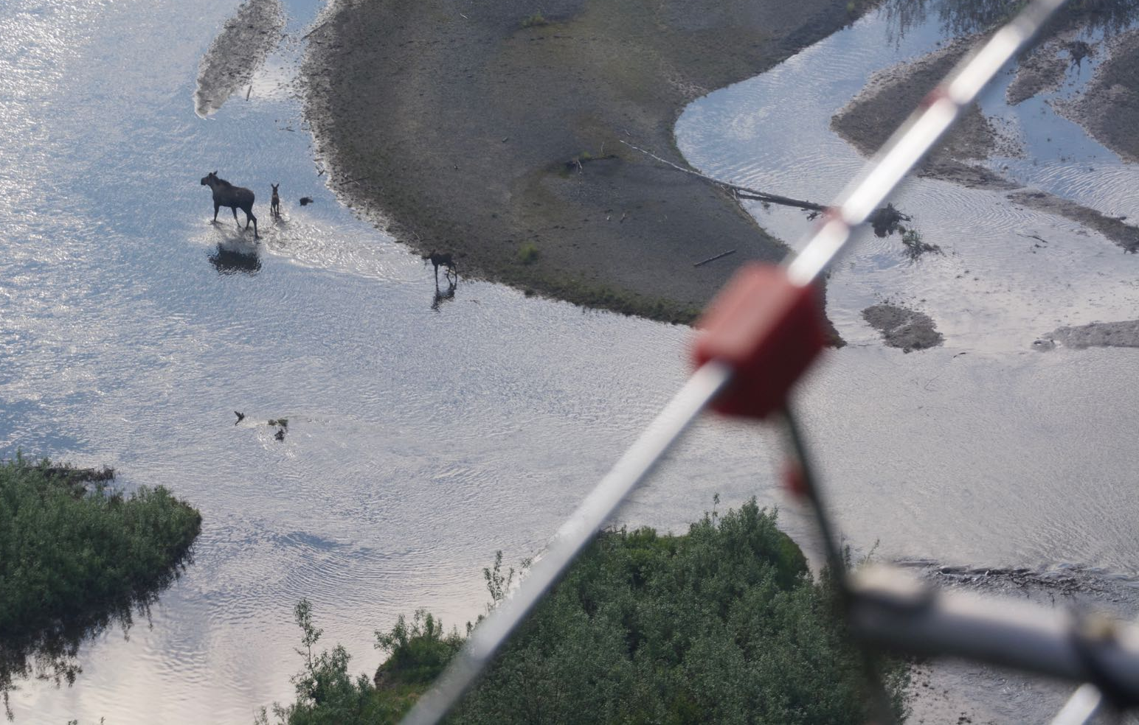
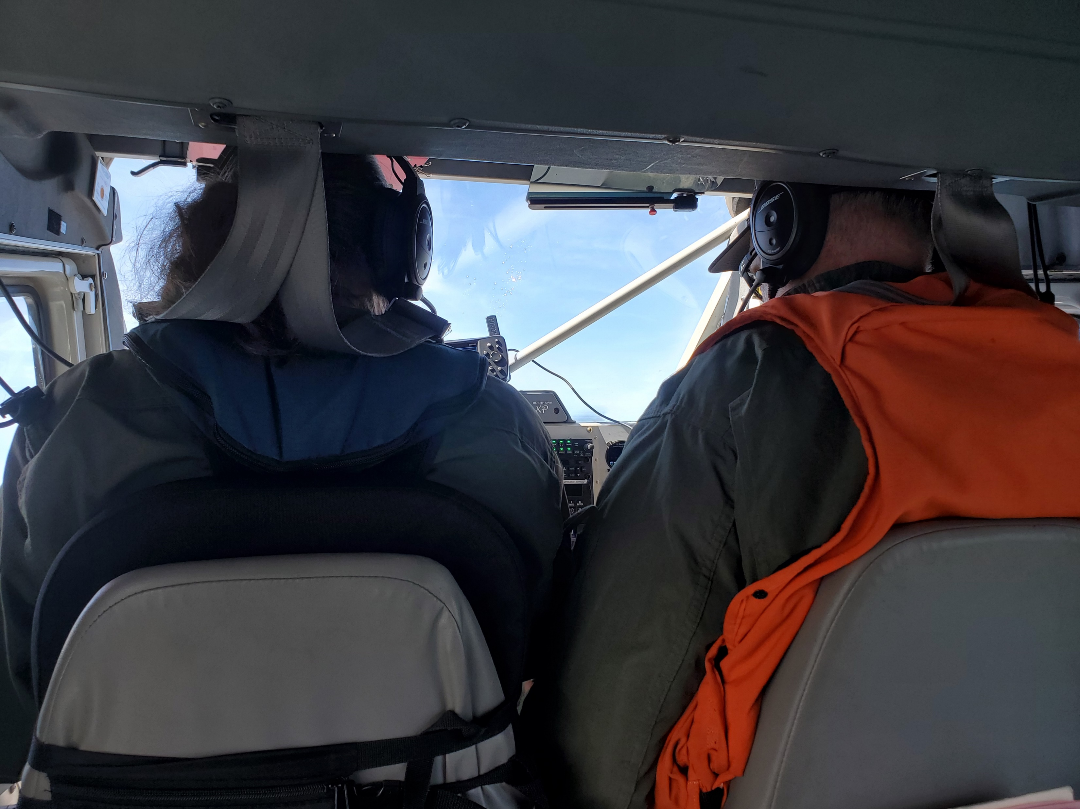
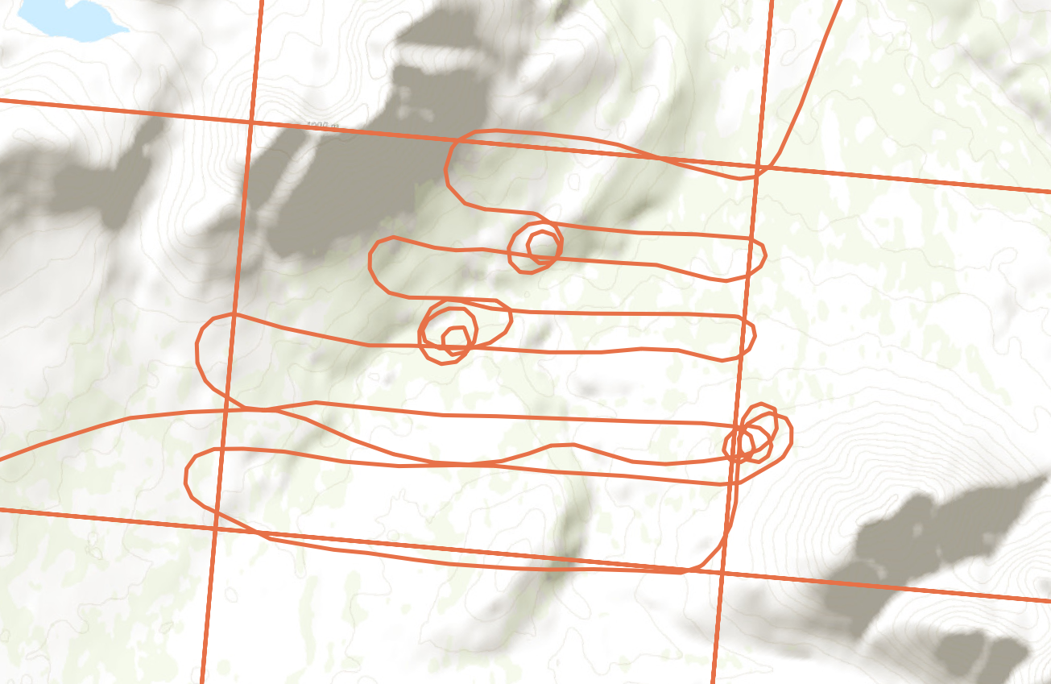
Long-term monitoring in TNWR: 1989-present
Telemetry
Census
Notes:
Don’t spend too much time here. Emphasize we’ll get into this more later

Slide 9
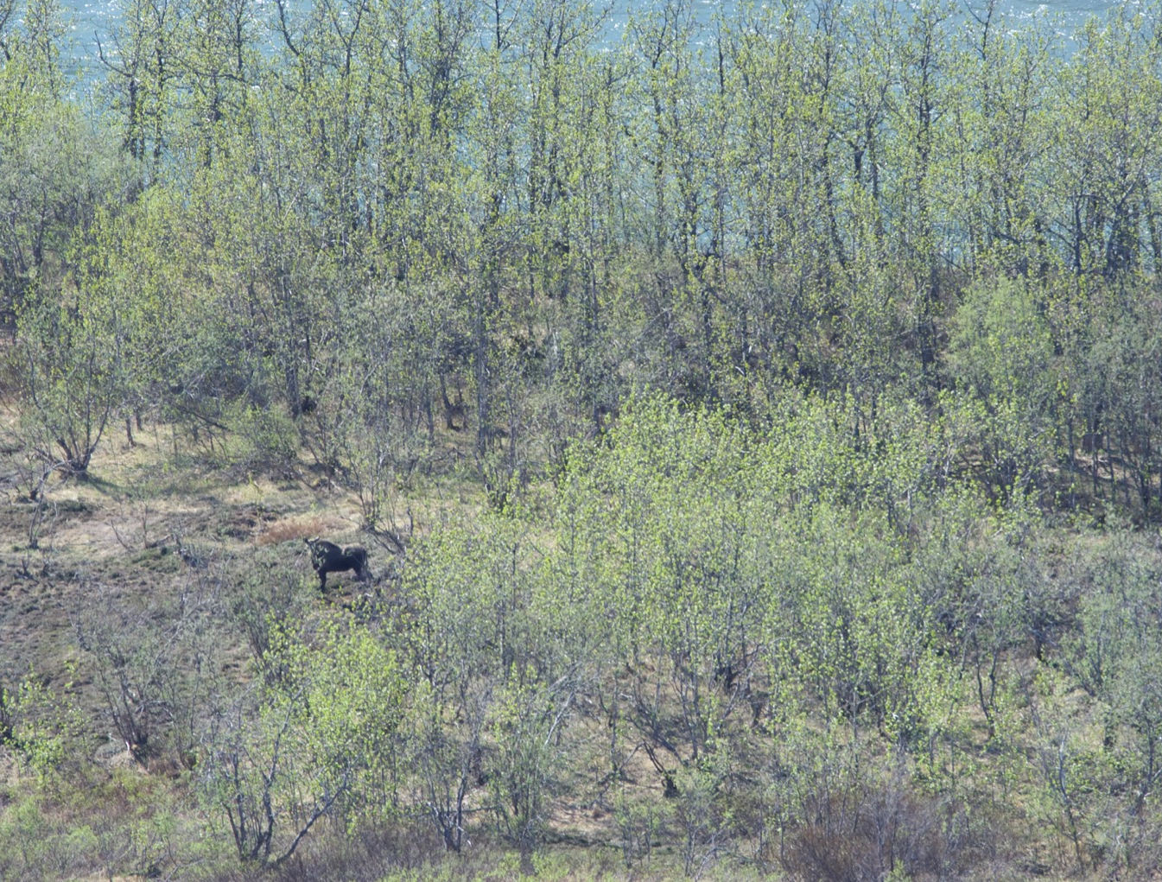
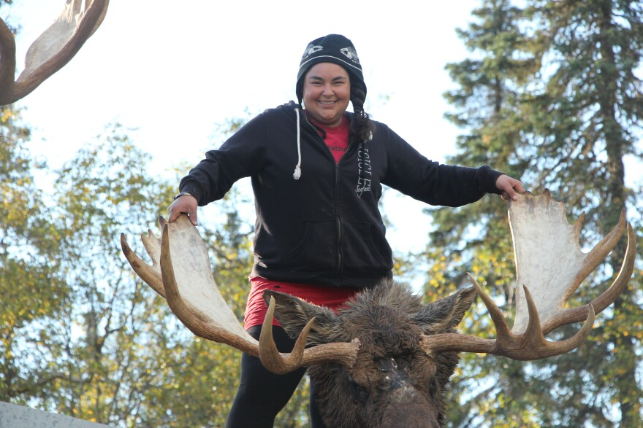
Factors that impact moose
Predation
Forage availability
Winter conditions
Disease
Human Hunting
Broader demographic parameters:
Age/Structure
Individual quality
Range expansions
Both North and South
Sweanor and Sandegren 1989; Franzmann and Schwartz 1998, Loison et al. 1999; Gaillard et al. 2000; Keech et al. 2011; Tape et al. 2016; Rosa et al. 2020; Ruprecht et al. 2020
PC: https://www.kdlg.org/environment/2015-09-21/hunters-return-with-moose-tales-aplenty
Notes:
Emphasize that conditions affect moose differently by habitat: rain is really good for them in Utah, but isn’t as strongly positive for them in rainier areas.
Also, each of these can be further split into different things – forage availability, for example, can be determined by things like growth season length, summer temperature, summer precipitation, etc.

Slide 10
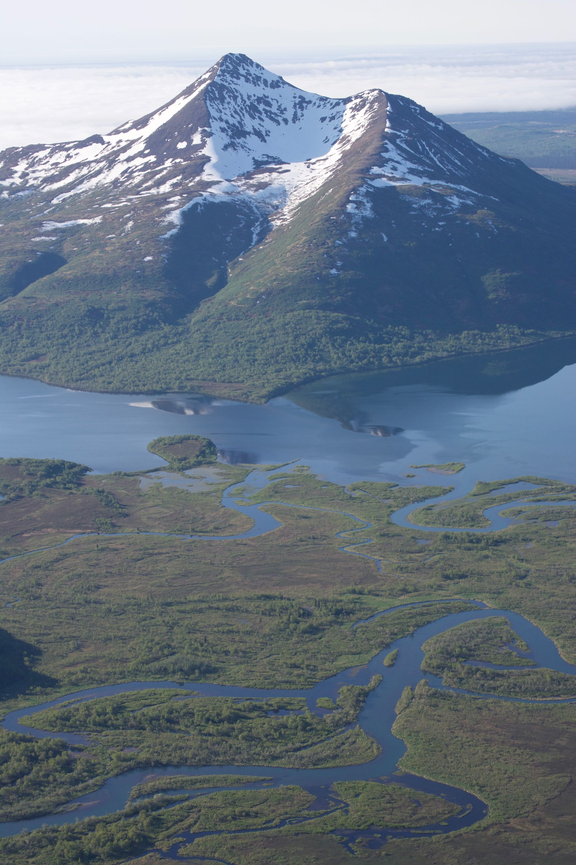
Moose in Togiak NWR
In October 2017, TNWR estimated the population at 3,336 moose
From ~12 to 3,336 = 278-fold increase
Moose colonization occurred concurrently with:
More frequent warm winters with wetter, more ephemeral snowpack
“Greening” of the area: increase in plant biomass
Changing hunting management by Game Management Unit (GMU)
Changing harvest dynamics with the Mulchatna caribou herd (MCH)
Valkenburg et al. 2003; Callaghan et al. 2011; Aderman 2014; Aderman 2019; Lader et al. 2019; Walsh & Brettschneider 2019; Frost et al. 2021; Macander et al. 2022

Slide 11
What have you noticed about moose in recent years?

Slide 12
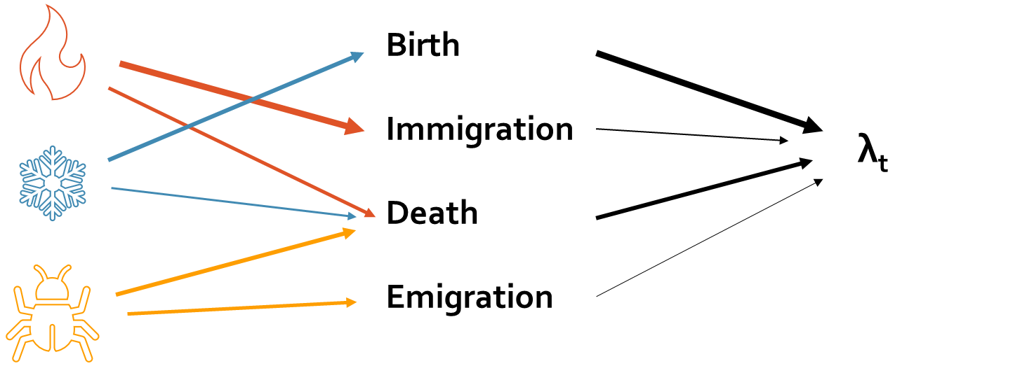
Questions/Hypotheses
What factors control population productivity?
High population productivity is facilitated by a combination of climate and human hunting pressure change
What factors actually control population abundance?
The most variable demographic rates for ungulates – calf survival and twinning – will actually affect population abundance the most
Notes:
This was only cows!!

Slide 13
Long-term monitoring in TNWR: 1989-present
Telemetry
Census
Notes:
Don’t spend too much time here. Emphasize we’ll get into this more later

Slide 14
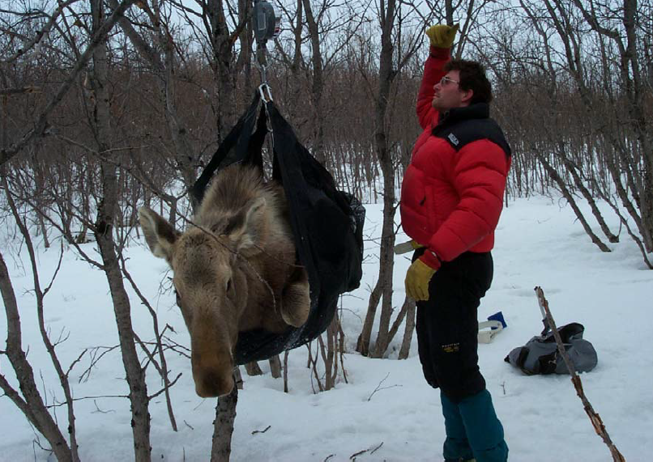
Telemetry Step 1: Capture and collar a moose
Capture a representative population of cows (~30/year) – 1998-present
Attach radio collar that emits a unique radio frequency
PC: Aderman 2007

Slide 15
Step 2: Find each moose ~1x/month
Notes:
Fly high and search for signals – line of sight so stay high! I’m taking the chance here to show what kinds of habitat exist in TNWR

Slide 16
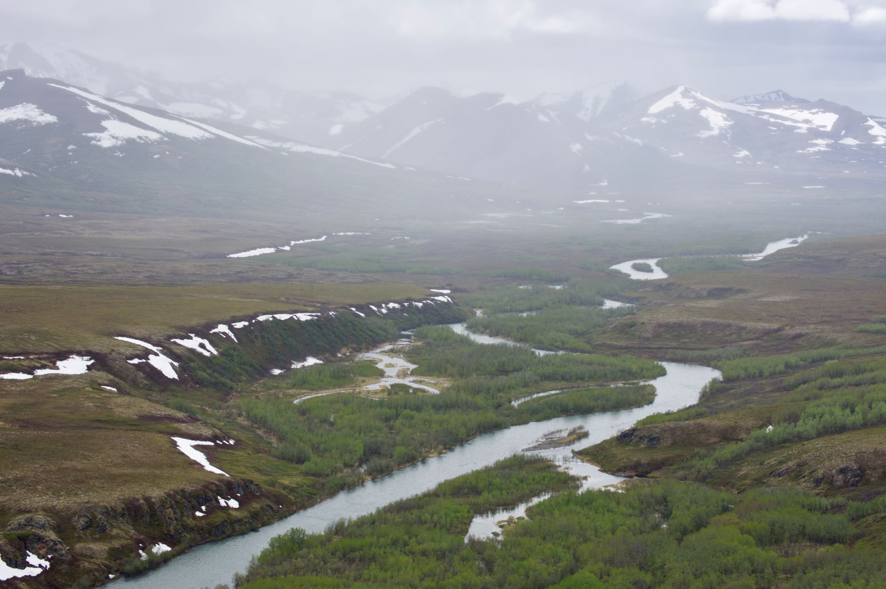
Step 2: cont’d

Slide 17
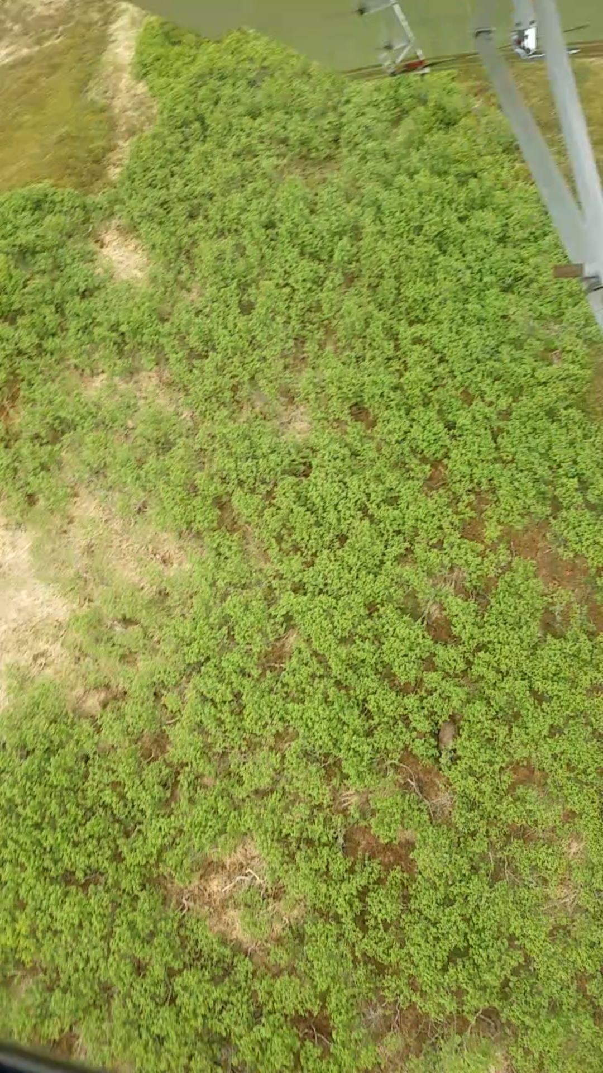
Step 3a: “Observe” the Moose
Notes:
Not always this easy…

Slide 18
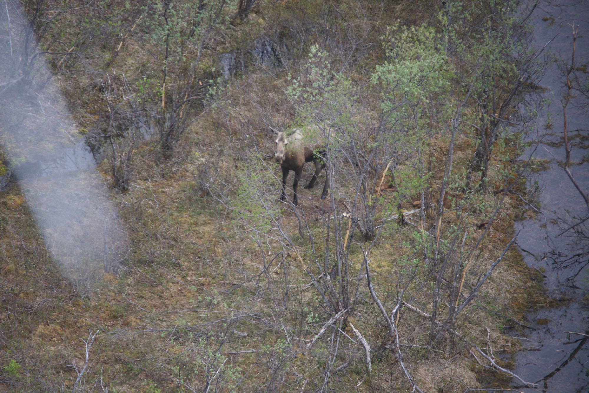
Step 3b: Observe the Moose
Notes:
Do you see the twins?

Slide 19
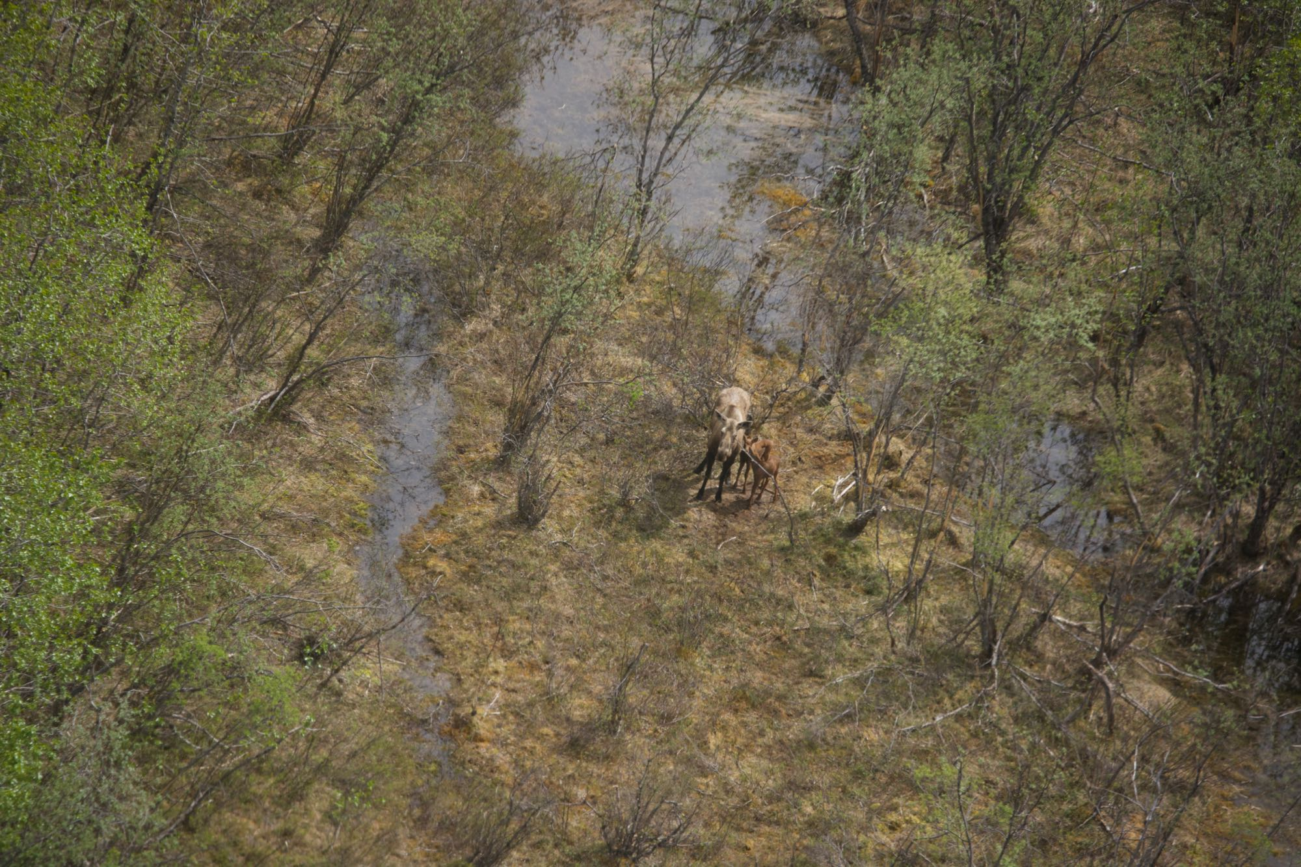
Step 3c: Observe the Moose
Notes:
Not always this easy…

Slide 20
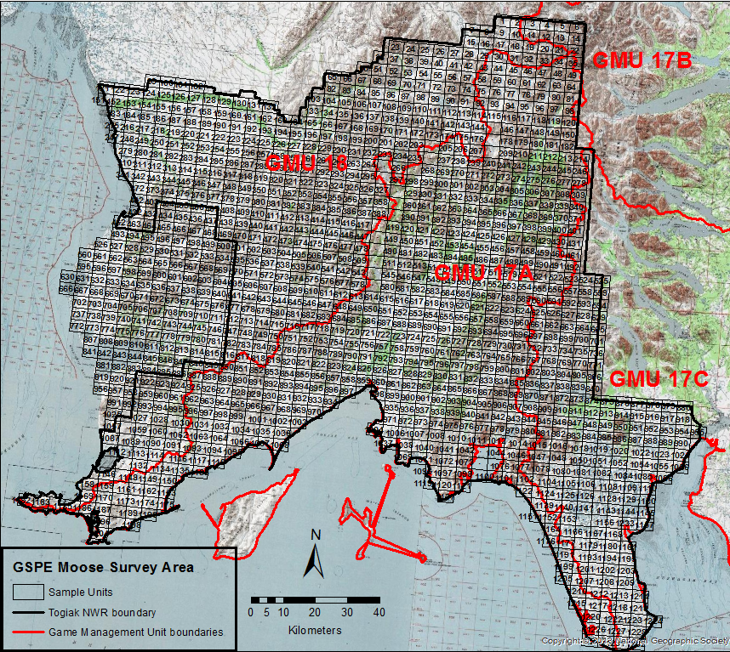
Counting Step 1: Make a grid

Slide 21
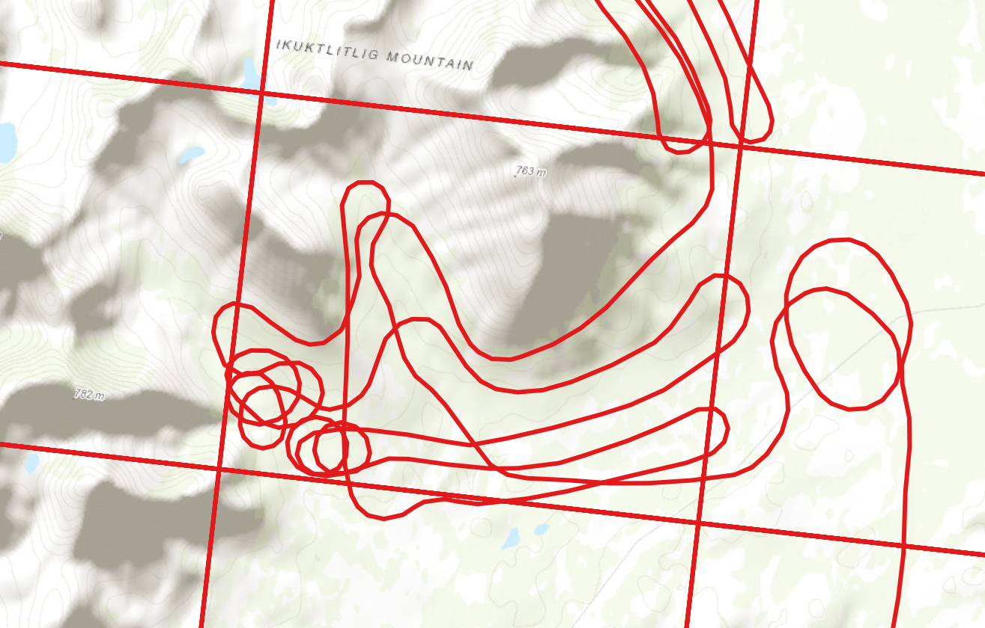
Step 2: Count a representative set of grids
Notes:
Focus a little more on how they were counted. Have Survey Units, similar to these, and extensively survey a pre-determined set of survey units.

Slide 22
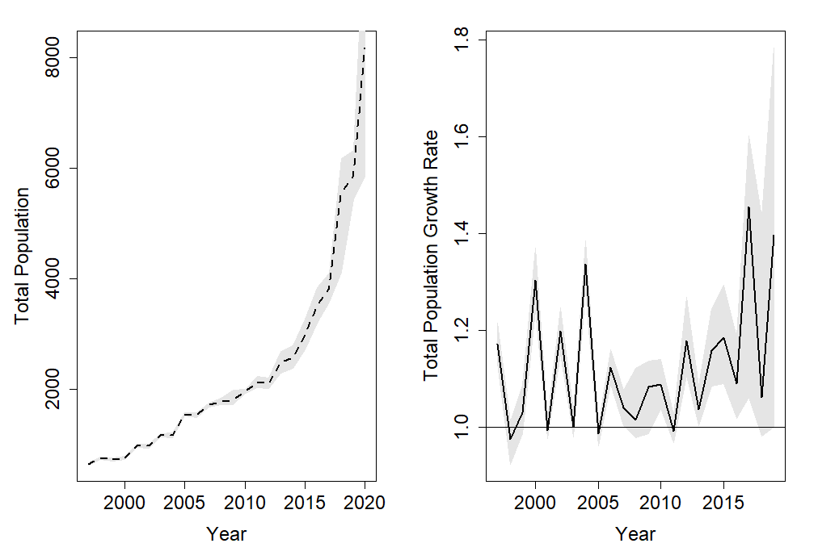
Results
Notes:
Total abundance – no surprise, the population exploded.

Slide 23
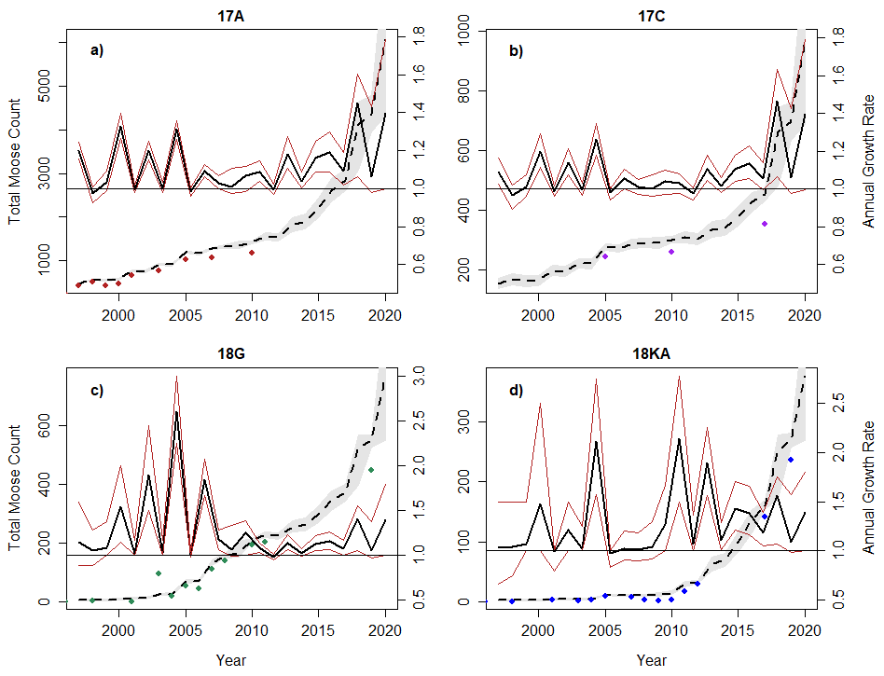
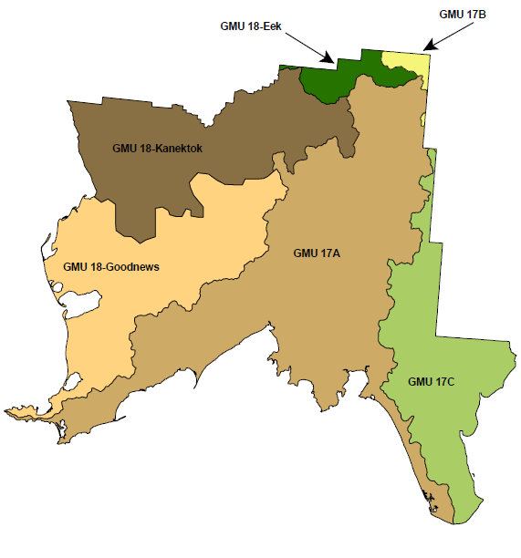
Results
18K
18G
17A
17C
Notes:
Solid line = 1.0
Point out the inconsistency of data points

Slide 24
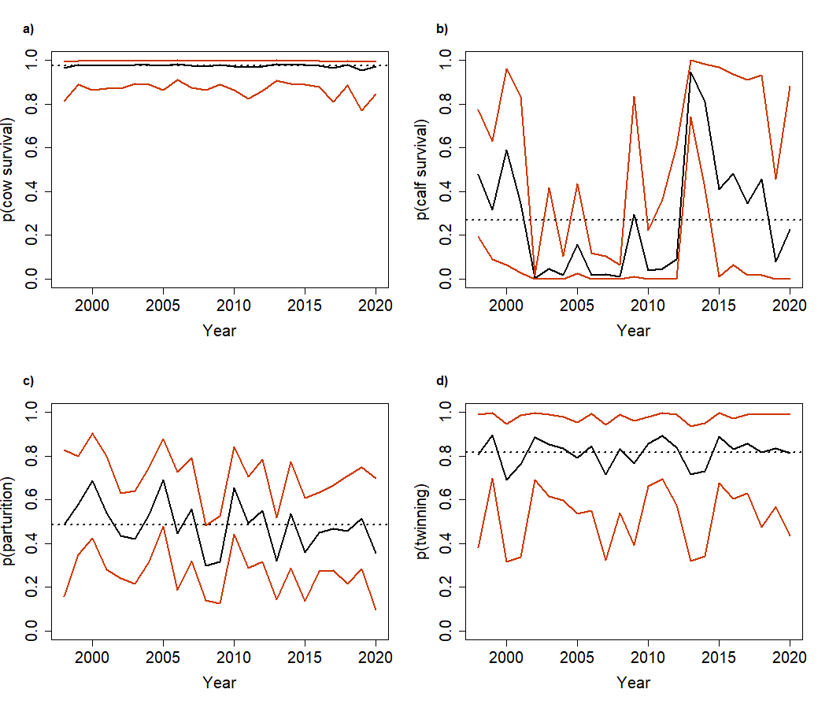
Results
Notes:
Dotted line = mean
Touch on variability of each, and how numbers compare to other studies:
Relatively normal calf survival, and really high variability
Low parturition rates
Very high twinning rates

Slide 25
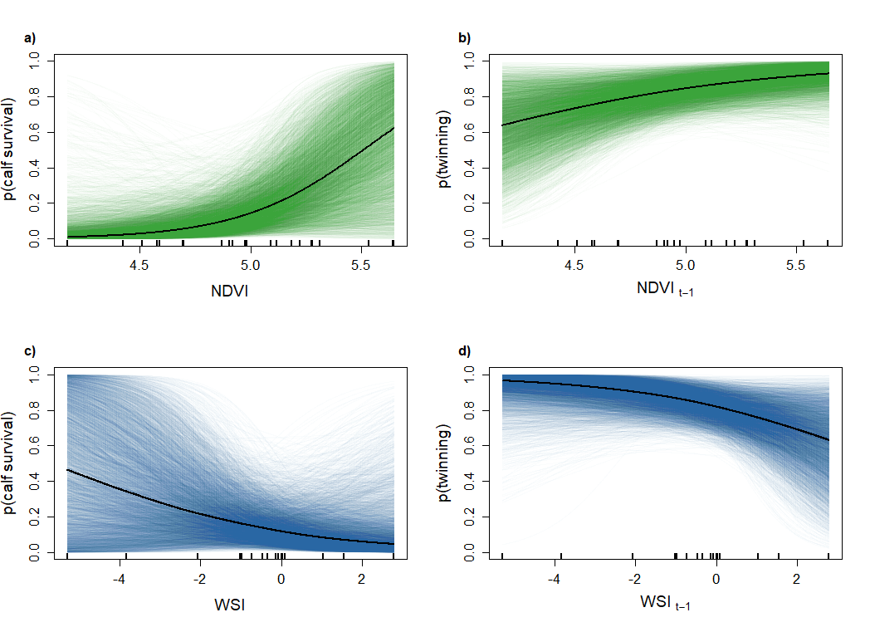
Results
Franzmann and Schwartz 1998; Boertje et al. 2019; Ballard et al. 1991, Keech et al. 2011

Slide 26
Results
Ballard et al. 1991; Franzmann and Schwartz 1998; Keech et al. 2011; Boertje et al. 2019;
Notes:
Ok, so after this slide, we have established that environmental variation affects moose, with not groundbreaking results that bad winters are bad for moose, and productive summers are good for moose. But how are these environmental factors interacting with demographic factors to eventually affect population abundance?

Slide 27
Cow survival
Calf survival
Parturition
Twinning
?
?
?
λ_{t}

Slide 28
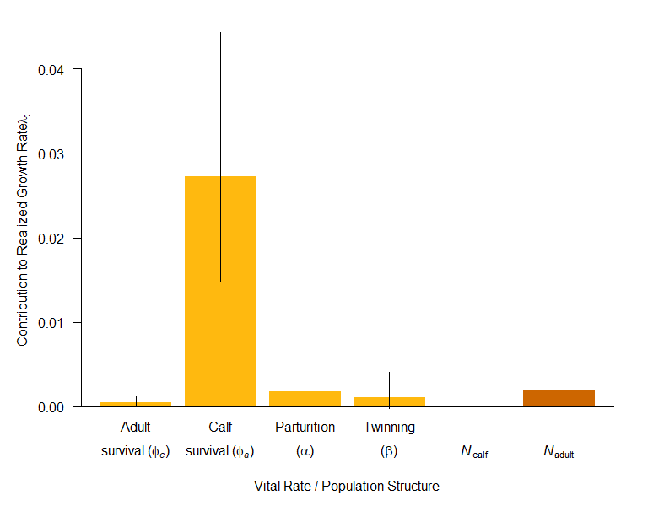
Results

Slide 29
Results

Slide 30
Conclusions
Environmental factors affected calf survival the most, and calf survival affected λ_{t} the most
Environmental factors impacted population growth rate through calf survival
The moose population has not reached carrying capacity
The transition of most impactful demographic rates from calf survival to parturition could indicate an approach to carrying capacity
Will need to keep monitoring to know when to change hunting regulations
Cow survival
Calf survival
Parturition
Twinning
λ_{t}
Notes:
All this has really important implications for moose and ungulates! Knowing these patterns can help us understand

Slide 31
Conclusions – What happened in TNWR?
Factors associated with climate change affected population growth
A harsher environment (more severe winters, less productive summers) could have limited population growth before 1950s
Hunting pressure possibly limited cow survival, which has the highest sensitivity
Possible storyline:
<1950s
-Less amenable habitat
-High hunting pressure
1950s-1980s
-Temperature increases -> less severe winters, more forage
-High hunting pressure
1990s
-Hunting pressure released as caribou increase
-Moose pop grows, takes advantage of pristine landscape
1990s-2020s
-MCH decreases
-Collaboration between TNWR, locals → hunting moratoriums
-Moose pop continues to grow
Sexton et al. 2009
Notes:
Important to note, is that a combination of climate and direct human activity impacted this population

Slide 32
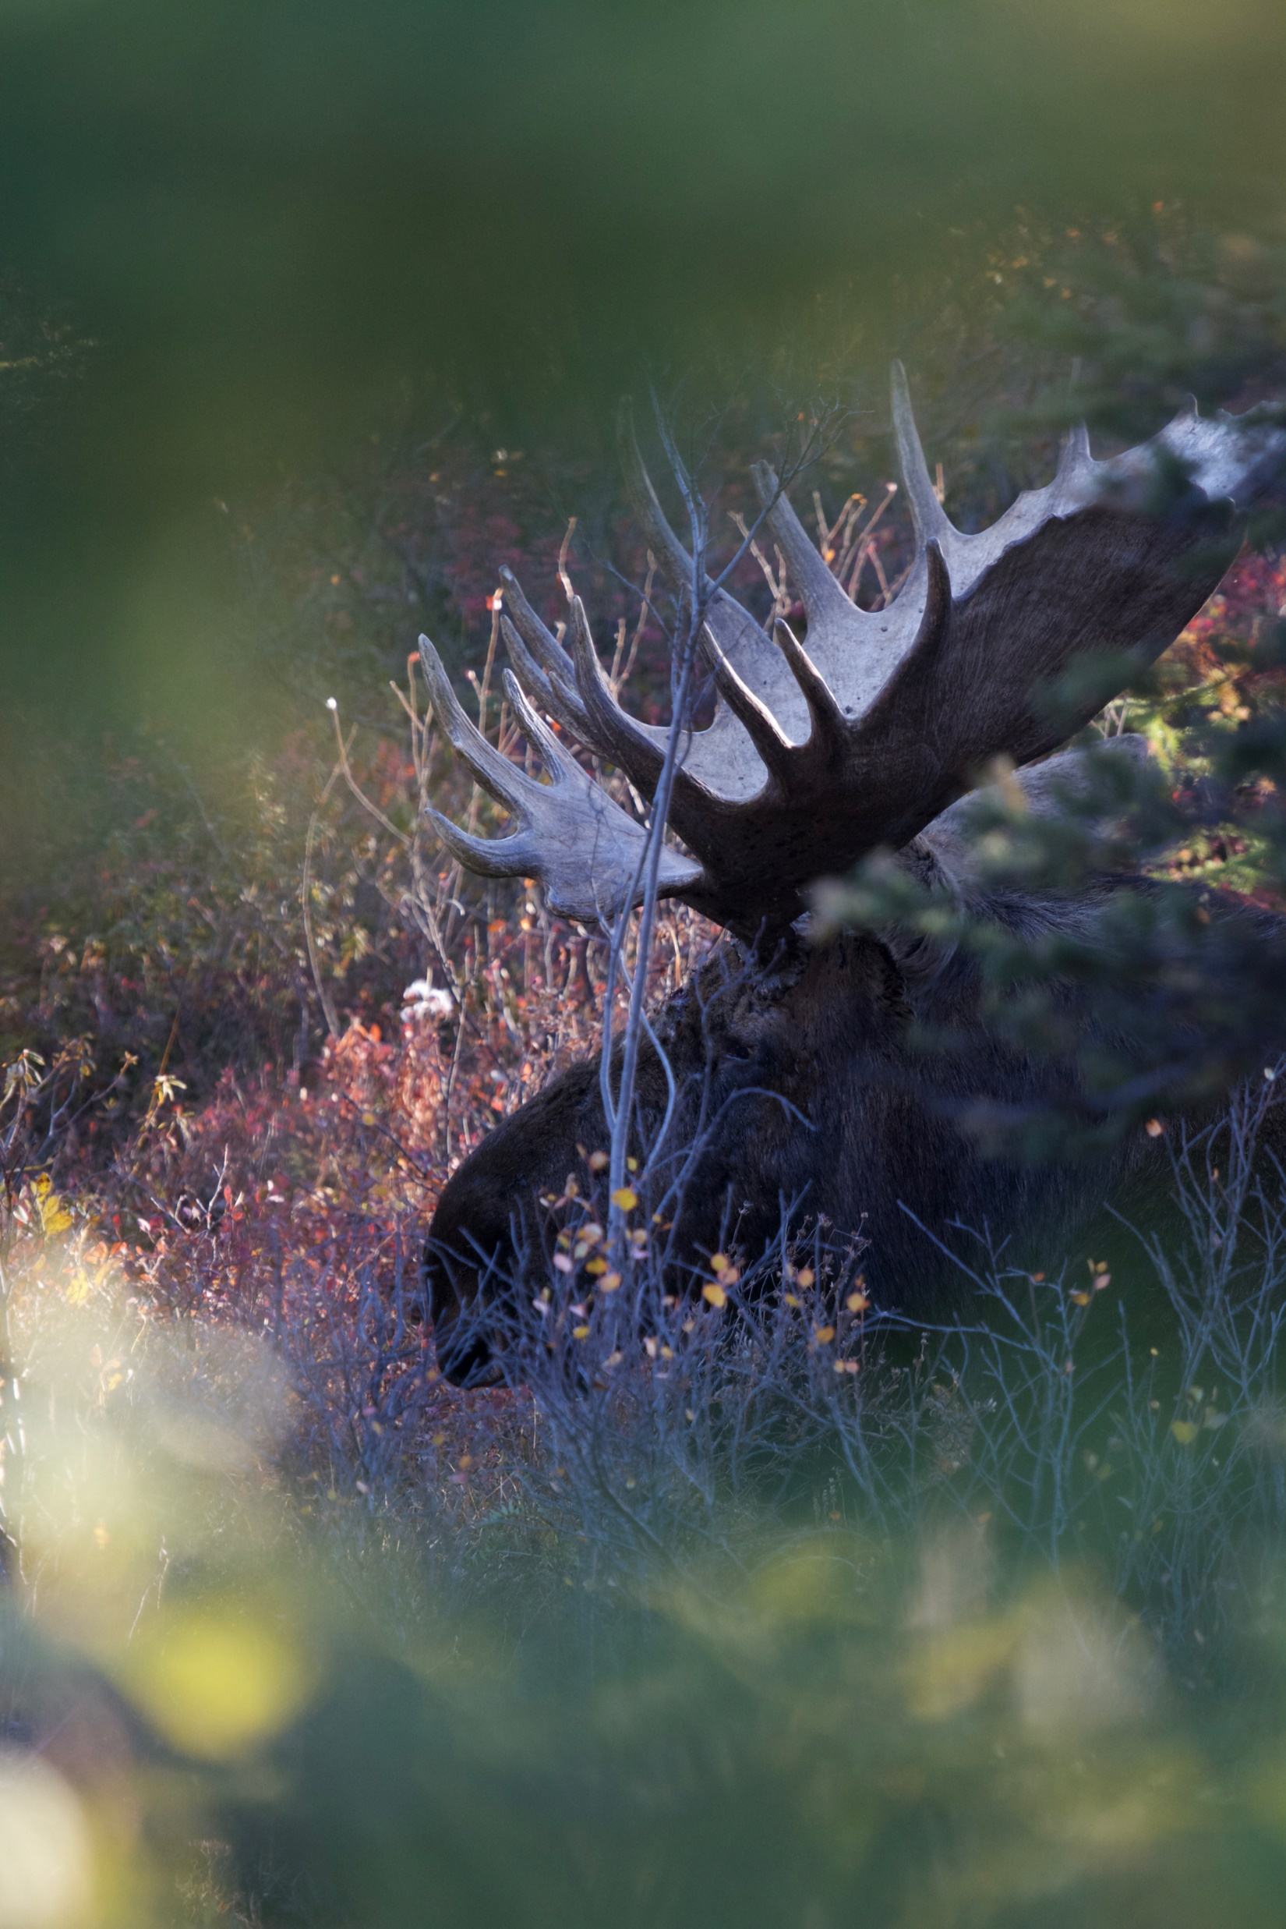
Thank you!
Advisor:
Dr. Shawn Crimmins, AKCFWRU
Committee:
Dr. Joseph Eisaguirre, USGS
Dr. Christa Mulder, UAF
Dr. Ken Tape, UAF
Data:
Togiak National Wildlife Refuge
Andy Aderman, Kara Hilwig, Pat Walsh…the whole crew!
Funding:
US Fish and Wildlife Service
Calvin J. Lensink Fellowship
Phillip Andrews Memorial Award
Jack R. Luick Memorial Travel Fund
Family and friends!

Slide 33
Questions? Comments?

