Slide 1
2024 Post Season Lunch and Learn
Notes:
Introduction

Slide 2
Togiak
Togiak transfer waived July 25
22 Drift registration by July 16
Used to be 40+ Through 2020
Maximum extensions Starting first week in July
361,578 escapement 565,314 harvest

Slide 3
June 18
Wood River First Day counts 606
Nushagak sockeye count 1,792 total 4,571
Nushagak trigger 210,00 sockeye
Wood River trigger 800,000 sockeye
June 28
DIVISION OF COMMERCIAL FISHERIES
Notes:
For me the most important decision of the season usually seems like the first one. When do we start fishing. This is especially true now that we have the king salmon stock of concern plan. I’m going to run through day by day the things we looked at and thought to give you a view through my eyes of how things developed in 2024.

Slide 4
June 19
Remember counts are through previous day
Wood River count 2,400 total 3,006
Nushagak sockeye count 3,605 total 8,176
June 18 was windy; Subsistence catches reported to be good
DIVISION OF COMMERCIAL FISHERIES
Notes:
Counts are through the previous day. I get my first count from sonar at 0730. Then Wood at 0740. These are the counts through midnight. We would also get counts between midnight and 0600, but for the sonar those are unapportioned.

Slide 5
June 20
Wood River count 22,584 total 25,590
Nushagak sockeye count 15,937 total 24,113
Nushagak king count 1,779 total 4,424
Escapement increased because of wind on 18th
DIVISION OF COMMERCIAL FISHERIES
Notes:
Starting to see some increase in escapement from the wind on the 18th.

Slide 6
June 21
Wood River count 63,300 total 88,890
Nushagak sockeye count 27,057 total 51,170
Nushagak king count 2,785 total 7,209
Escapement still strong because of wind on 18th
Old rules would have allowed fishing to start today
DIVISION OF COMMERCIAL FISHERIES

Slide 7
June 22
Wood River count 33,330 total 122,220
Nushagak sockeye count 21,334 total 72,514
Nushagak king count 1,655 total 8,864
Test boats start today
Forecast shows wind late on June 25 –June 27
DIVISION OF COMMERCIAL FISHERIES
Notes:
Unlike 2023, when escapement was slow early then built steadily for the most part, 2024 had an early pulse then slowed more and more each day. The count today was half the previous day for the Wood and 75% for the Nushagak.

Slide 8
June 22 Tim’s Thoughts
Port Moller index and genetics similar to 2023 for Nushagak
Project short notice announcement Monday June 24
Be ready to fish Tuesday evening the 25th
Wait as long as possible to let kings move through on the wind
DIVISION OF COMMERCIAL FISHERIES
Notes:
I shared this in an email on the 22nd. Trying to give folks an idea of how I thought the next few days would play out.

Slide 9
June 23
Escapement dropped again
Wood River count 19,896 total 142,116
Nushagak sockeye count 15,833 total 88,347
Test boats report fish in the district but milling
Subsistence fishing is slow
DIVISION OF COMMERCIAL FISHERIES

Slide 10
June 24
Escapement dropped again
Wood River count 11,568 total 153,684
Nushagak sockeye count 4,042 total 92,389
Short notice announcement
Reports of fish moving through the district during the day
Aerial survey of district shows very little
DIVISION OF COMMERCIAL FISHERIES

Slide 11
June 25
Escapement dropped again
Wood River count 3,168 total 156,852
Nushagak sockeye count 760 total 93,149
Test boats out early two south of district, one north; slow fishing
Aerial survey in evening bad weather, poor visibility no fish visible
DIVISION OF COMMERCIAL FISHERIES
Notes:
Remember the triggers 210,000 for Nush 800K for Wood.

Slide 12
June 26
Wood River count 33,750 total 156,852
Nushagak sockeye count 7,375 total 100,524
Escapement up on the 25th a little
Morning counts show fish are moving
Make 0900 announcement for set
Make noon announcement for drift
DIVISION OF COMMERCIAL FISHERIES
Notes:
There are no announcement times between 8:00 p.m. and 9:00 a.m. Once we saw nothing on the evening of the 25th we were committed to nothing until the afternoon of the 26th. High tide at 7:23 a.m. started with 18.5 hour set and 14 hour drift openings.

Slide 13
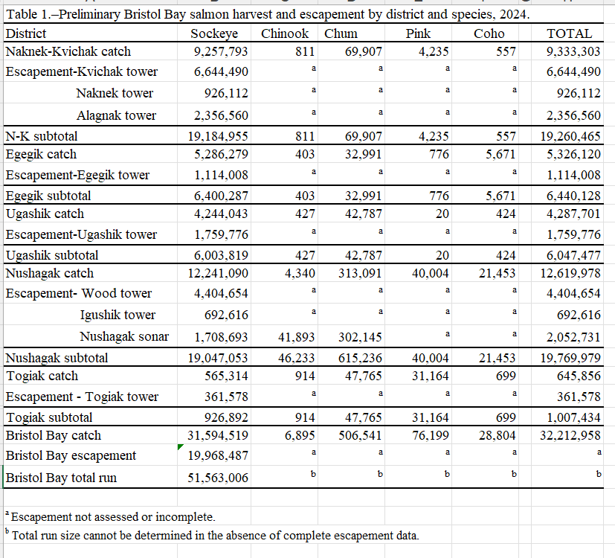

Slide 14
Allocation

Slide 15
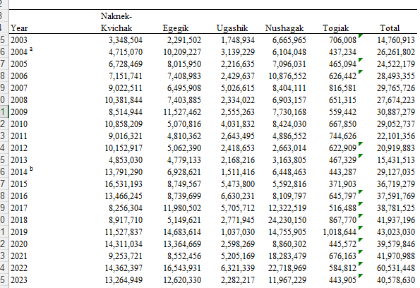
Notes:
6th best harvest by number ever probably 8th best by poundage. 6th best in last 8 years.

Slide 16
Fishing Time
2023/2024 Drift 428.5/416
2023/2024 Set 486/464
Smallest fish size ever
80% 1.2’s in Nushagak District

Slide 17
Expoitation

Slide 18
Mesh Selectivity
Courtesy BBSRI
DIVISION OF COMMERCIAL FISHERIES

Slide 19
Mesh Selectivity
DIVISION OF COMMERCIAL FISHERIES

