Slide 1
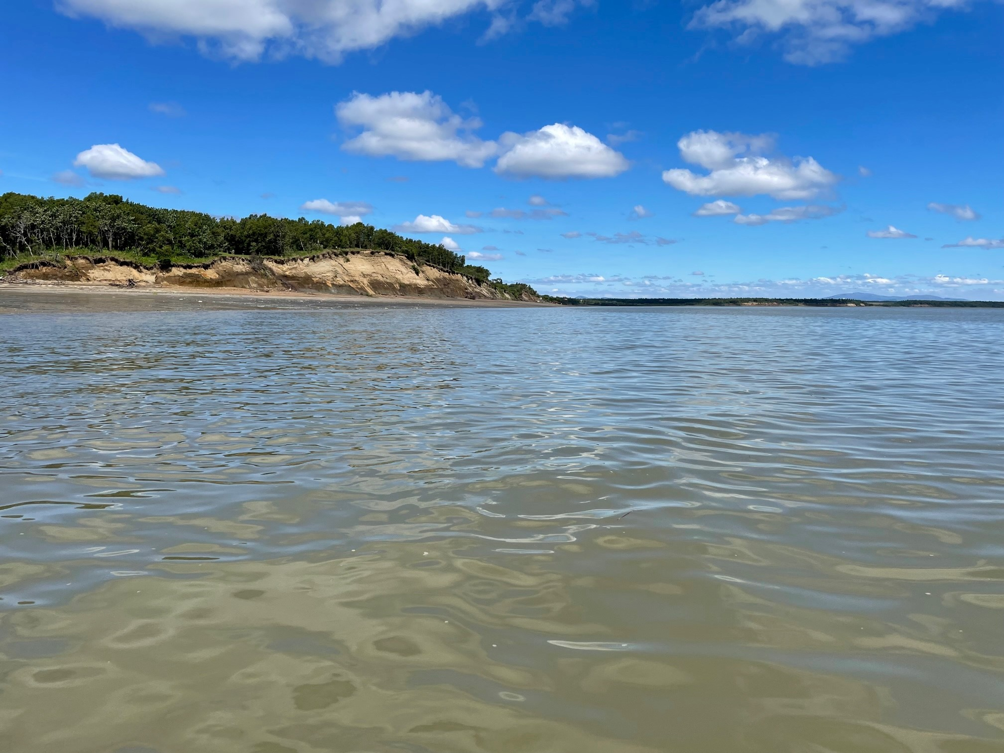

Dillingham Pathogens
Water Quality Monitoring Project
2022-2023
Alaska Department of Environmental Conservation
With data support from Alaska Water Laboratories, LLC

Slide 2
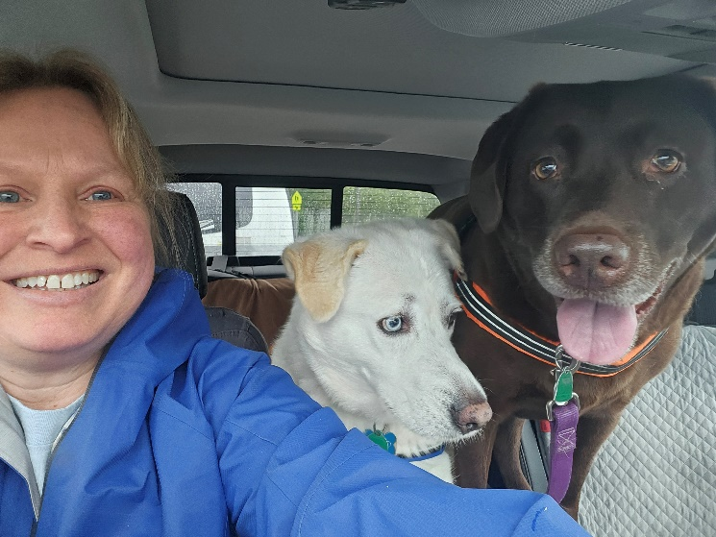
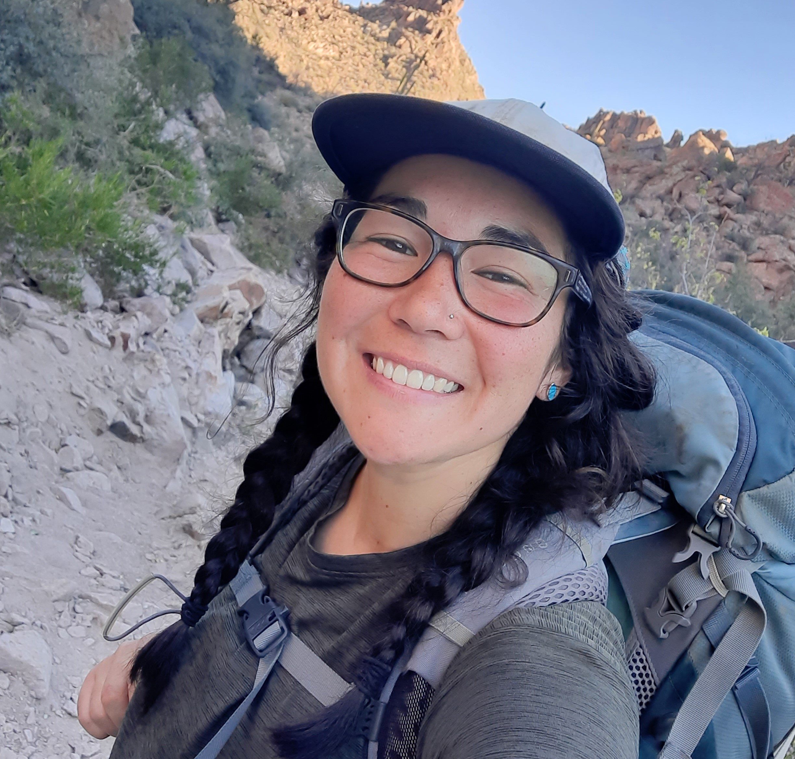

Introductions
Mary Curry
Lab Director and Manager
Alaska Water Laboratories, LLC
Wasilla, AK
Laura Eldred
Section Manager, Nonpoint Source Water Quality
Alaska Department of Environmental Conservation
Phone: (907) 376-1855
Email: laura.eldred@alaska.gov
Mary Inovejas
Environmental Program Specialist
Alaska Dept. of Environmental Conservation
Nonpoint Source Water Quality
Phone: (907) 269-7518 Email: mary.inovejas@alaska.gov

Slide 3
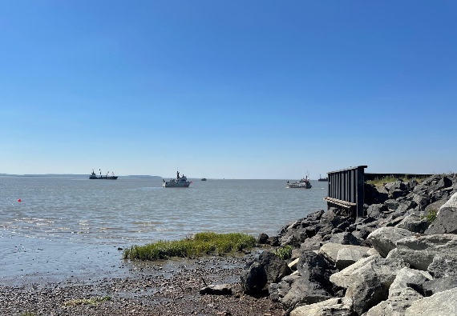
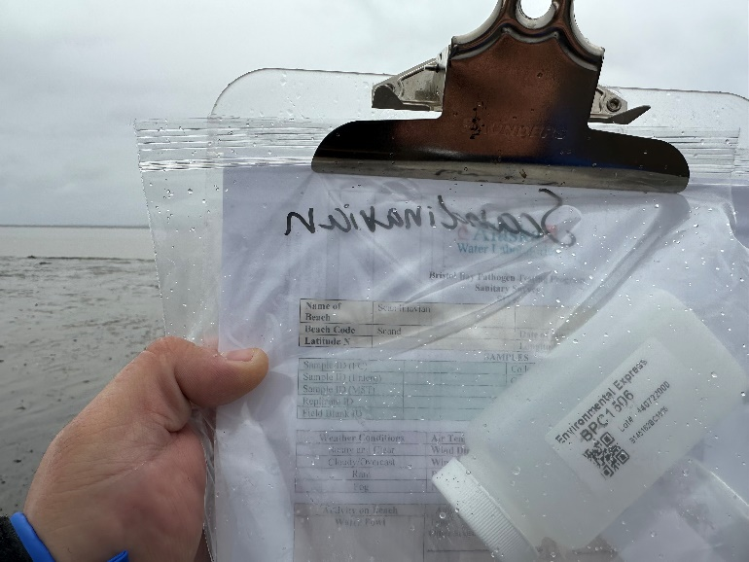
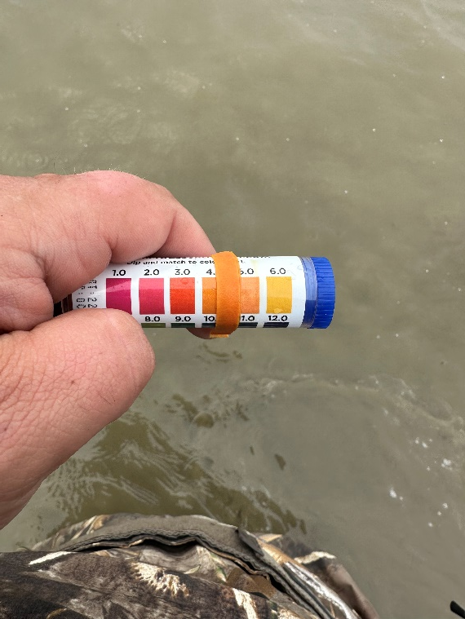
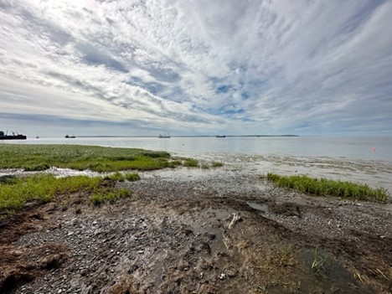
Project Background & Goals
Background:
Sample collection occurred between May and August during the summers of 2022 and 2023
Alaska Water Laboratories collected near-shore water samples from 3 Dillingham beaches
Pathogen monitoring was conducted in Dillingham in 2006, 2008, 2009, and 2010
Objectives:
Monitor recreational beaches for fecal indicator bacteria
Identify possible bacteria sources through Microbial Source Tracking (MST) – a type of DNA speciation

Slide 4
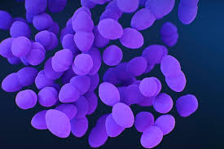
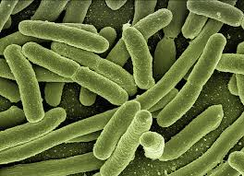
What are we monitoring for?
Enterococci
Although these pathogens are generally not harmful themselves, they indicate the possible presence of disease-causing bacteria, viruses, and protozoans that also live in the digestive systems of humans and other warm-blooded animals.
The presence of fecal coliform and enterococci in a waterbody suggests that harmful bacteria might also be present, posing a health risk.
Fecal coliform

Slide 5


Water Quality Criteria
Recreation (Primary Contact)
In a 30-day period, the geometric mean of samples may not exceed 35 enterococci CFU/100 ml
Not more than 10% of the samples may exceed a statistical threshold value (STV) of 130 enterococci CFU/100 ml.
Harvesting Raw Mollusks or Other Raw Aquatic Live for Consumption
The geometric mean of samples may not exceed 14 fecal coliform/100 ml
Not more than 10% of the samples may exceed 31 CFU per 100 ml for a membrane filtration test
&
*18 AAC 70 WATER QUALITY STANDARDS

Slide 6


Slide 7
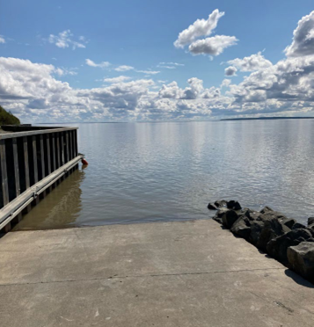
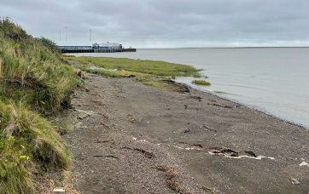
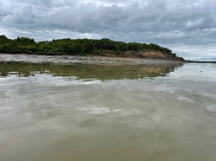
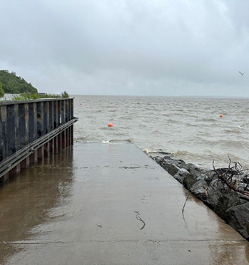
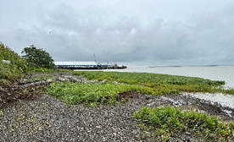
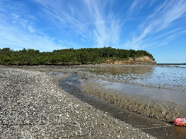
Snag Point
Scandinavian Beach
Kanakanak Beach
2022
2023

Slide 8
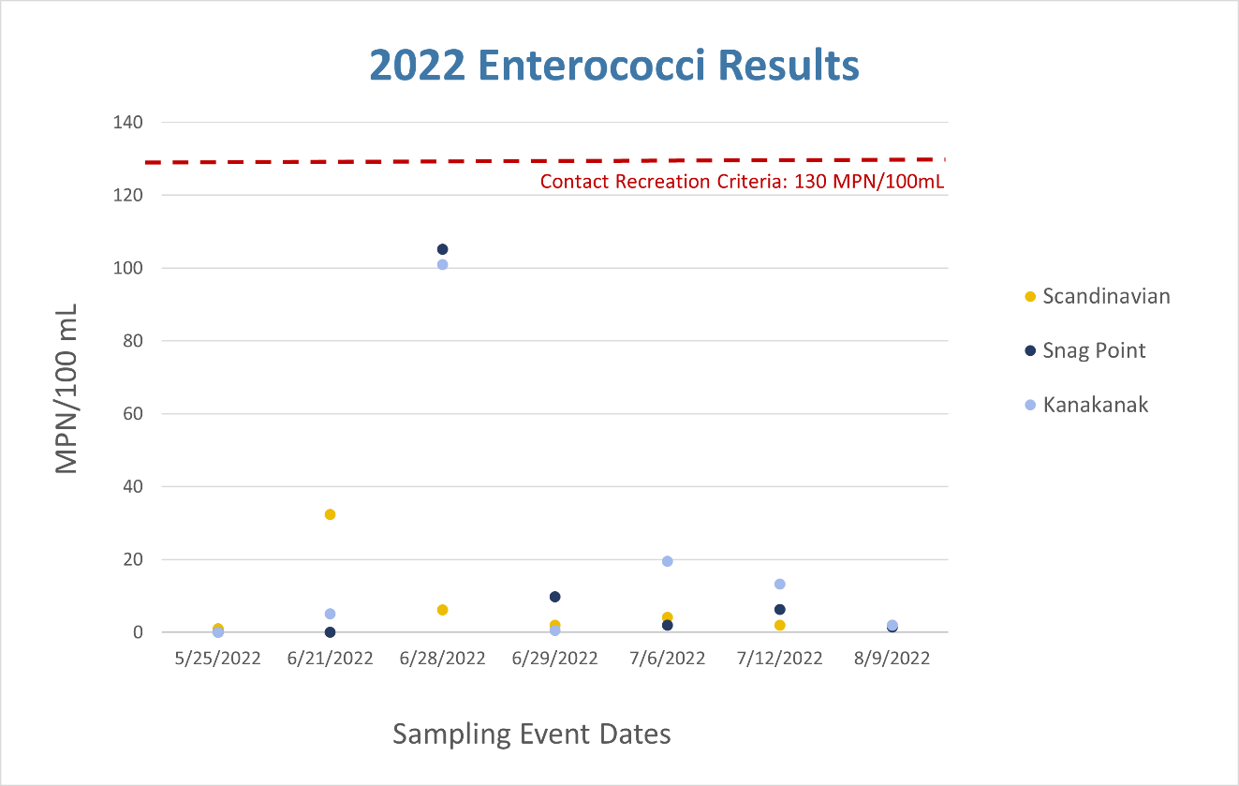
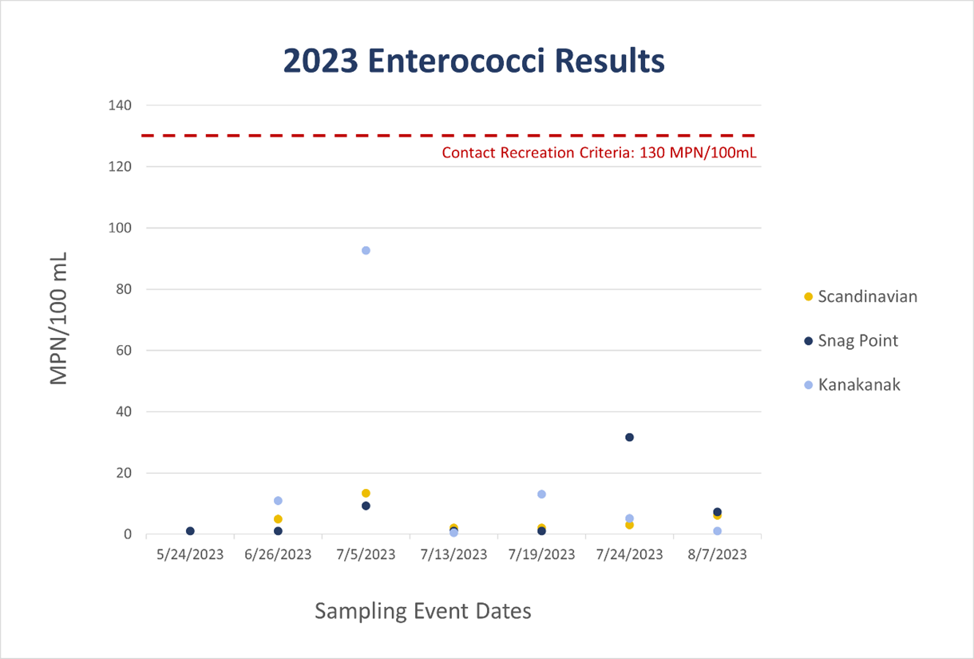
Results from 2022 enterococci analyses, all sites.
Results from 2023 enterococci analyses, all sites.

Slide 9
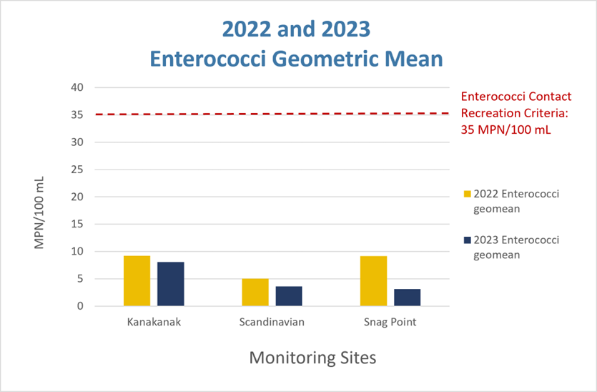
2022 and 2023 geometric mean results for enterococci, all sites.

Slide 10
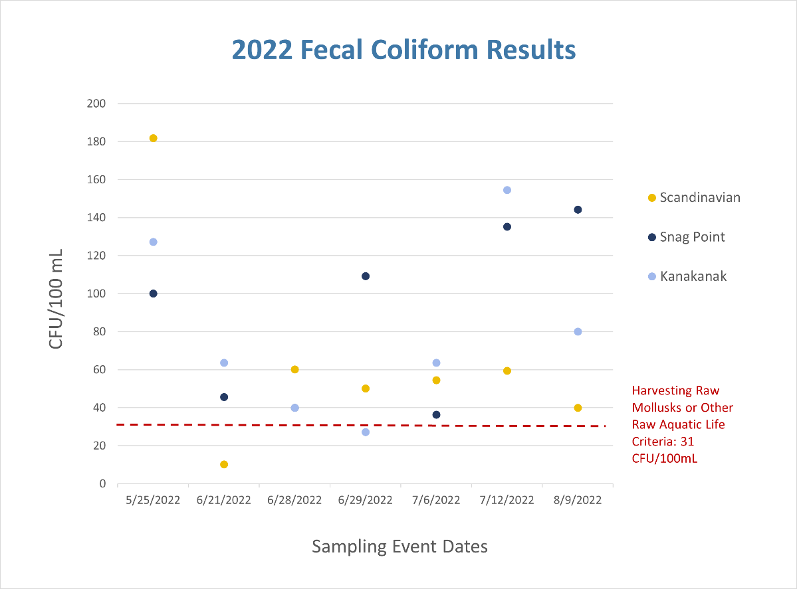
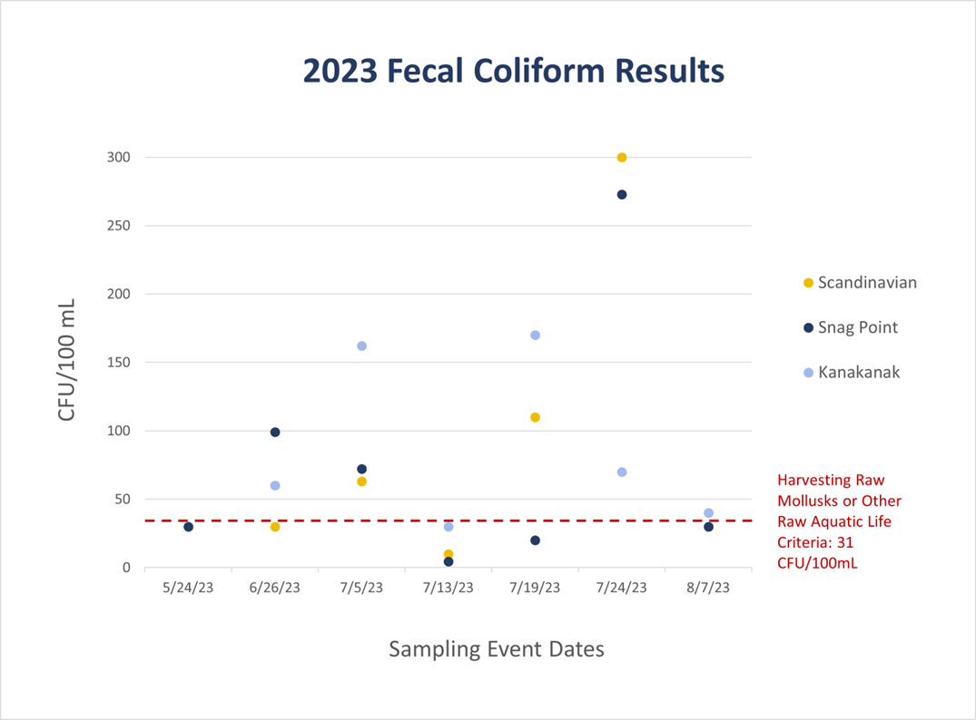
Results from 2022 fecal coliform analyses, all sites.
Results from 2023 fecal coliform analyses, all sites.

Slide 11
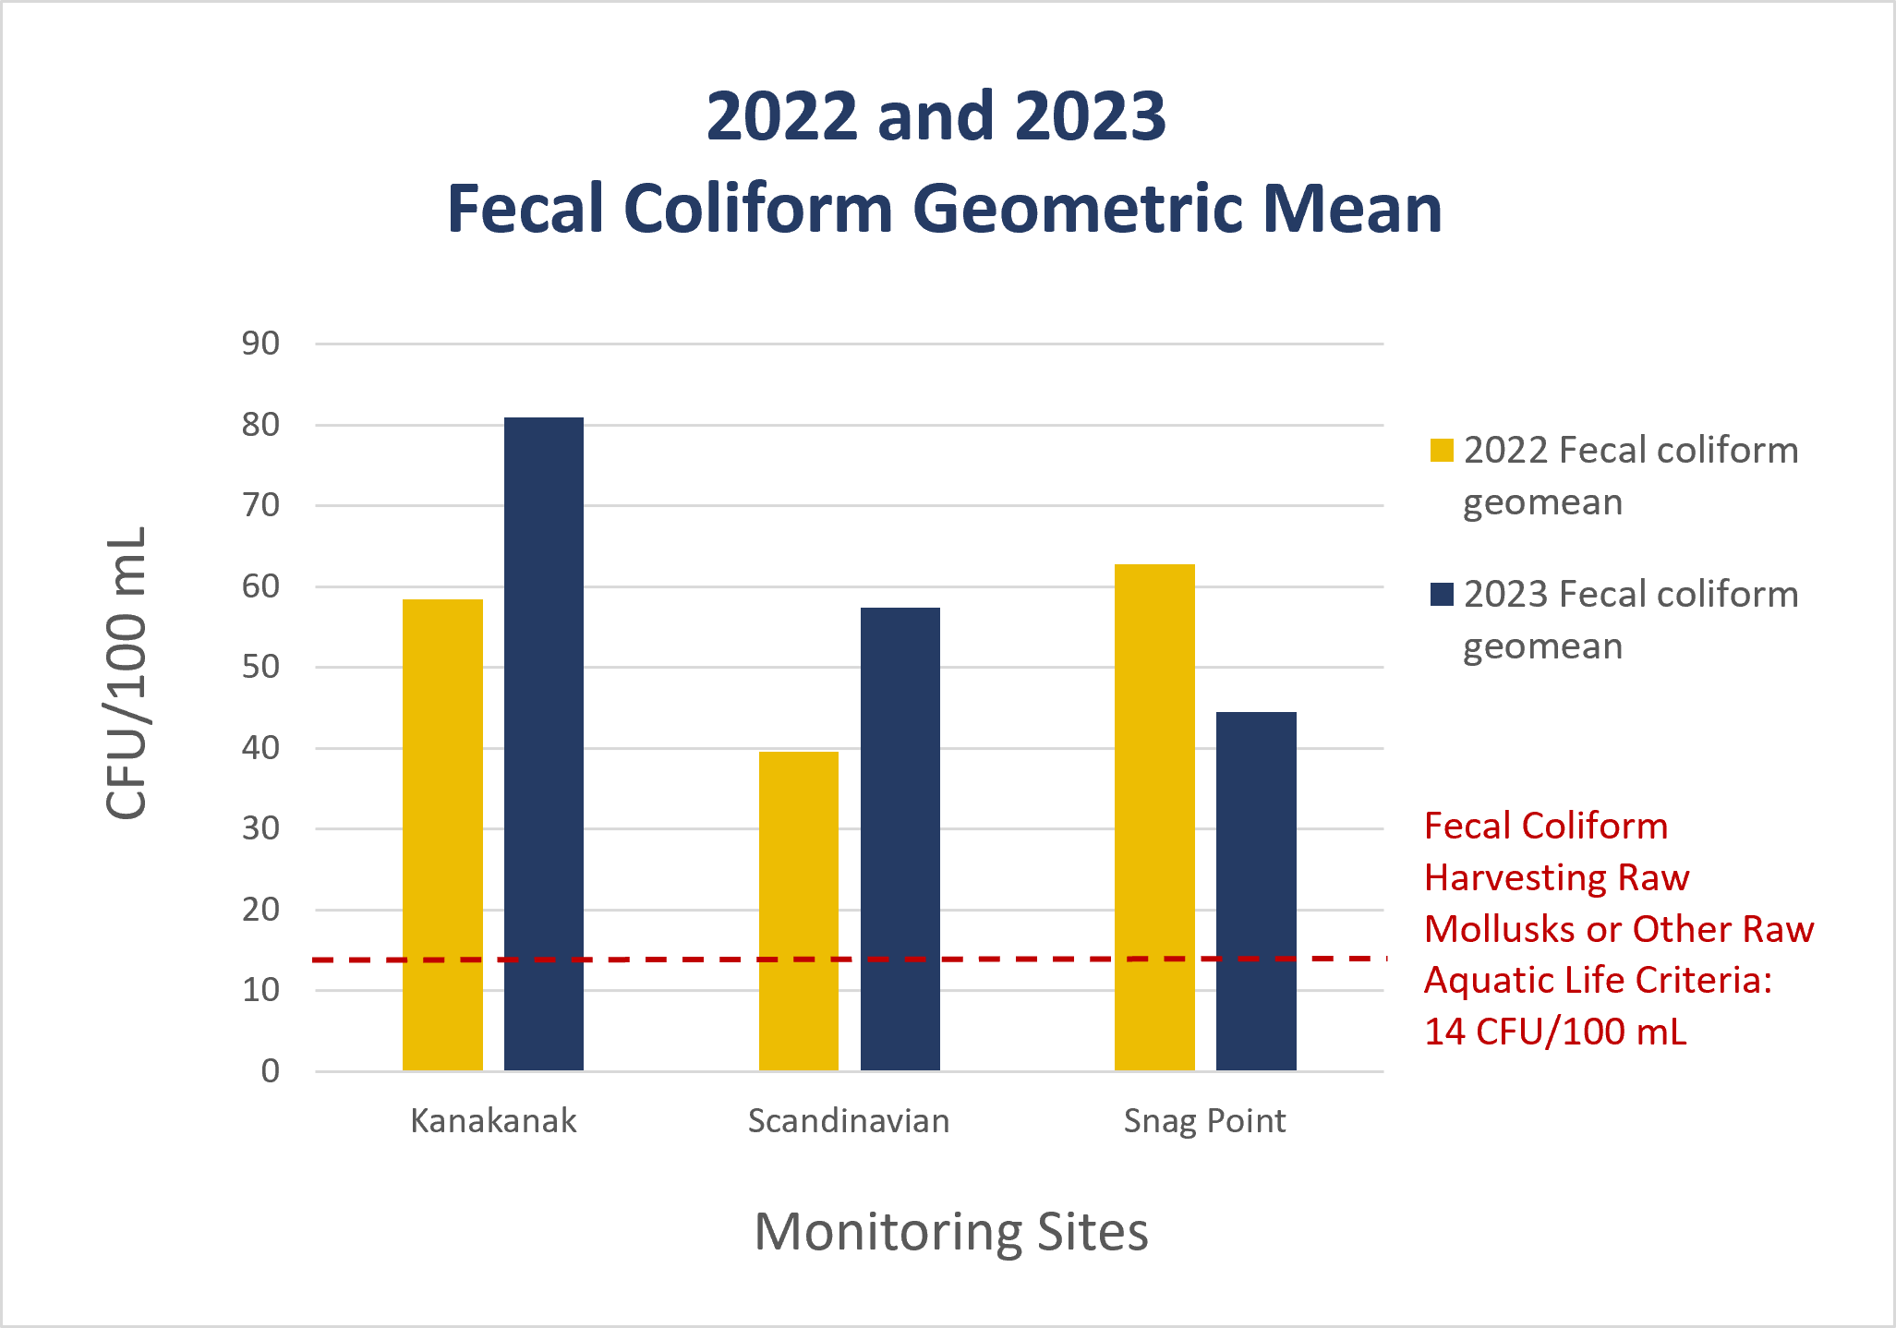
2022 and 2023 geometric mean results for fecal coliform, all sites.

Slide 12
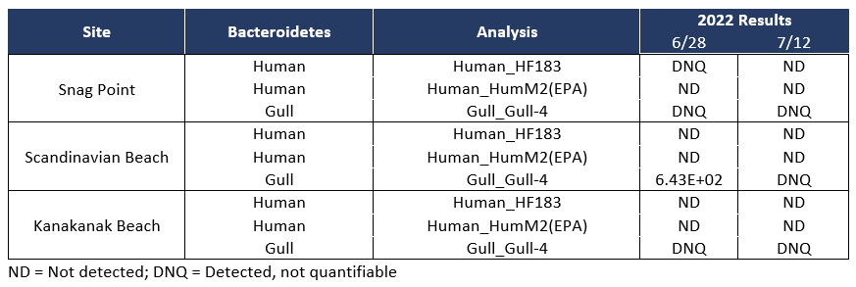
2022 Microbial Source Tracking (MST) Results

Slide 13
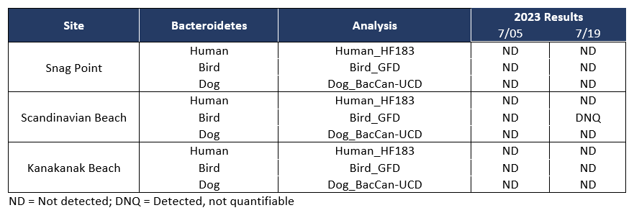
2023 Microbial Source Tracking (MST) Results

Slide 14
Conclusion
The final results indicate varying bacteria levels during both years, with no persistent human-caused bacteria pollution. The primary suspected source is naturally occurring from gulls.
Please follow safe food handling recommendations and cook seafood to a minimum internal temperature of 145 degrees Fahrenheit to destroy any bacteria. Note that freezing alone does not kill pathogens.

Slide 15



For more information on….
Dillingham Pathogen Monitoring Project Highlights, visit:
https://dec.alaska.gov/water/water-quality/project-highlights-newsletters
2022-2023 Dillingham Pathogens Monitoring Final Report, visit:
https://dec.alaska.gov/water/water-quality/nonpoint-source-control/water-quality-resources/reports
State of Alaska Water Quality Standards, visit:
https://dec.alaska.gov/water/water-quality/standards/
Food safety and sanitation, visit:
https://dec.alaska.gov/eh/fss/resources-printable/

Slide 16
Thank you!
Questions?

