Slide 1
Graduating students & serving our communities
FY15 Operating & Capital Budget requests
August 2013

Slide 2
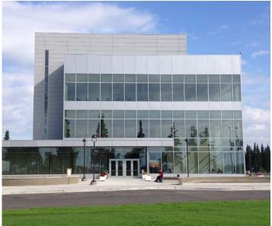
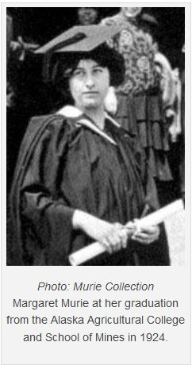
Research & teaching excellence
Margaret Murie Building
Ribbon Cutting August 2013

Slide 3
Award-winning faculty
A. David McGuire, College of Natural Sciences & Mathematics (CNSM) & USGS
AAAS Fellow for distinguished contributions to terrestrial ecology
Erin Petit, CNSM
National Geographic Society Emerging Explorer for glacier research and “Girls on Ice” outreach program
Ray Ralonde, Alaska Sea Grant Marine Advisory Program
Superior Outreach Program Award, National Sea Grant
Mary Ehrlander, College of Liberal Arts
Charles Gates Award, Washington State Historical Society Board of Trustees
Stephen Jewett, School of Fisheries and Ocean Sciences
American Academy of Underwater Sciences Conrad Limbaugh Memorial Award for Scientific Diving Leadership

Slide 4
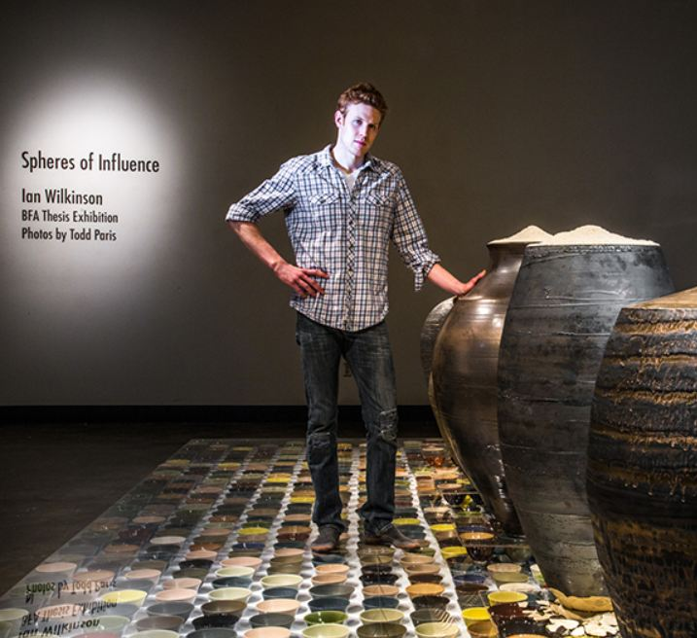
Student excellence
Bente Heller, junior majoring in business
UAF’s 1st NCAA championship in swimming (100-meter backstroke)
Nanooks claim AK Governor’s Cup
12th time in tournament’s 20 year history
Ian Wilkinson, art major
BFA thesis project, Spheres of Influence, raised more than $18,000 for the Fairbanks Food Bank

Slide 5
UAF Honors Program & URSA
Honors Program
21st year; 232 active student members
Growing by 15% annually
18% increase in graduation/ completion rate in the past year
Awards over $60k in programmatic scholarships each year
Undergraduate Research & Scholarly Activity (URSA)
30% of baccalaureate graduates have an undergraduate research experience
Funding for students & faculty mentors: $200k since 2011; investing 1% of ICR
Over 60 undergraduates presented at UAF Research Day

Slide 6
Strategic directions: raising the bar
Student achievement & attainment
Intensive advising to improve academic success
Attain baccalaureate six-year graduation rate of 40% (2016)
Expand eLearning & distance education
Centralize student interface, distribute revenue & credits
Updating general education requirements
Communicate academic quality & economic benefit
$1M for smart classrooms
Alternative offerings
WINTERMester, MAYMester, summer, weekends

Slide 7
Strategic directions: raising the bar
Productive partnerships with schools
CLA $1.9M grant for improving K-12 outcomes for Alaska Natives
Effie Kokrine Charter School & IAC offering low cost, college level general education & electives through Tech Prep
Yoshikawa (INE) permafrost monitoring network >165 K-12 schools in Alaska & Arctic nations
Collaborative Teaching Models (CRCD) in Math

Slide 8
What a Joy!
Nanooks welcome Joy, the 727 jet recently donated by FedEx
The CTC Aviation Program is FAA-certified, and is one of few that can be completed in 12 months

Slide 9
Strategic directions: raising the bar
Productive partnerships with industry
Mining
Mineral Industry Research Laboratory with Kinross Fort Knox and Sumitomo Metal Mining/Pogo
$3M donated to support graduate research opportunities
Fisheries
FSMI partnerships with the Pollock Conservation Cooperative Research Center
Aviation
FedEx to support aviation maintenance
Fairbanks Economic Development Corporation
Commercialization of research

Slide 10
UAF research leads to inventions
Invention Disclosures by Year
OIPC’s efforts began in 2011; in FY12 32 invention disclosures resulted in six patents filed by UAF
In FY13, the number more than doubled, as part of the vigorous IP & commercialization identification efforts, putting UAF in line with peers

Slide 11
Strategic directions: raising the bar
R&D for Alaska’s communities
Nanook Innovation Corporation (non-profit) & Nanook Tech Ventures (for-profit subsidiary)
Infrasound microphone (defense & surveillance - Northrup Grumman)
Alaska Center for Unmanned Aircraft Systems Integration
One of six centers, also partnered with Oregon & Hawaii
Alaska Satellite Facility dish
Alaska EPSCoR
Center for Alaska Native Health Research (CANHR)
$5.3M grant for researching Alaska Native Health disparities
12 pilot projects for UAF junior scientists & researchers

Slide 12
Strategic directions: raising the bar
Accountability to the people of Alaska
Process improvement & efficiency
Employee pre-recruitment (HIRED)
Award set-up (GPS)
Procurement (SUPER)
Travel (TRIP)
Student business processes
Marketing & Communications intake & workflow
Ongoing assessment – support programs
Academic and research program review

Slide 13
Student achievement & attainment
Baccalaureate FTFTF1-year retention (%)
76.5 |  |  |  | 79.3 |  |  |  |  | 82.8
Baccalaureate FTFTF 6-year graduation rate (%)
32.6 |  |  |  |  |  |  |  |  | 38.2
Associate-level FTFTF 1-year retention (%)
47.0 |  |  |  |  |  |  |  |  | 53.7
Associate-level FTFTF 3-year graduation rate (%)
12.0 |  |  |  |  |  |  |  |  | 23.0

Slide 14
Student achievement & attainment
Baccalaureate Track-15 (%)
29.7 |  |  |  |  |  |  |  |  | 32.2
Associate Track-15 (%)
10.5 |  | 11.4 |  |  |  |  |  |  | 15.7
Student credit hours (thousands SCH)
168 |  |  |  |  |  |  | 188 |  | 192
eLearning student credit hours (thousands SCH)
18.7 |  |  |  |  |  |  |  |  | 25.9

Slide 15
Research & development
Research expenditures ($M)
$110 |  |  | $114 |  |  |  |  |  | $124
Ph.D. awards
37 |  |  |  |  |  |  |  |  | 52

Slide 16
Accountability
University generated revenue ($M)
$213 |  |  |  |  |  |  |  | 237 | $244
Tuition & fee revenue ($M)
$35.7 |  |  |  |  |  |  |  |  | $47.3
Instructional expenditure/SCH ($)
$778 |  |  |  |  |  | $811 |  |  | $827

Slide 17
FY14: Strategic reductions to enable investment
Balance the budget & preserve quality programs
Move programs out of leased space onto campus
Energy conservation & management
Vacancy management
Vice Chancellor plans in lieu of ATB pullback
Campus & community feedback opportunity for cost savings & efficiencies
http://bit.ly/UAFbudget

Slide 18
Implementing sustainable change
Administrative Services
Reorganize Dining & Polar Express with Bursar’s Office; eliminate vacant positions
Office of Information Technology
Explore service consolidation & delivery
University & Student Advancement
Downsize Career Services, reduce services & create new long-term plan for student career support
Eliminate Athletics administrative position through reorganization; reduce travel

Slide 19
Implementing sustainable change
Provost’s Office & academic programs
Eliminate administrative, support & faculty positions where vacancy exists or can be managed
Two associate deans, eight faculty, eleven staff
Reduction of eleven graduate assistantships at various schools/colleges
Merger of SNRAS & CES
Research
Eliminate VCR administrative position
Discontinue ARSC funding increase(s)

Slide 20
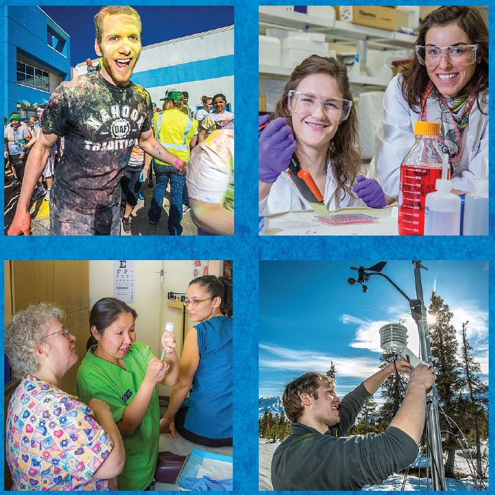
FY15 Operating Budget request

Slide 21
Fixed costs
Personal services
Faculty/staff raises $3.4M GF / $3.4M NGF
STEM faculty market adjustment $1.5M / $1.5M
Non-personal services
Smart classrooms, library $410k / $1.7M
Coop. Extension NRF replace $400k / ($400k)
Facilities M&R $1.2M / $720k
Utility costs $2.6M / $700k
New facilities $400k /$65k
P-3 housing $0 / $5M

Slide 22
FY15 Operating Budget increments
Strategic direction requires strategic investment
UA / UAF can help the state through budget challenges
We need to make the case for strategic investment in higher education & research

Slide 23
Student achievement & attainment
Alaska 2+2 collaborative Veterinary Medicine program : $200k / $243k NGF
Essential faculty clinical-community PhD & undergraduate Psychology program: $454k
Nursing faculty at Bristol Bay Campus: $50k / $50k
Mandatory comprehensive student advising (CRCD): $197k / $14k
STEM capacity & student success in general Chemistry – gateway to science & engineering careers: $140k / $53k
E-Learning expansion for online high demand job degree areas: $576k / $170k
*Note light blue items received part funding in previous years.

Slide 24
Productive partnerships with Alaska’s public/private industries & schools
Chemical Engineering program: $500k / $120k
UAF Film program expansion: $215k / $90k
Workforce development – expand Construction Trades program: $46k / $20k
Museum curator for Alaska Native cultural artifacts & asst. professor: $44k /$40k
Fisheries Seafood & Maritime Initiative: $315k
Math prep. program in rural high schools: $136k
Increase engineering graduates: $120k / $32k

Slide 25
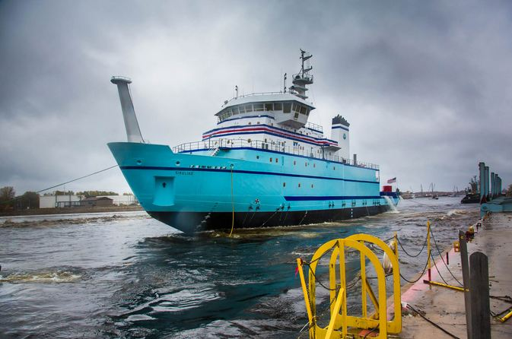
R&D to sustain Alaska’s communities & economic growth
Alaska critical & strategic minerals, fossil fuels & energy: $495k / $500k
Commercialization of intellectual property for business development: $200k / $50k
Ship time for Alaska specific research: $500k / $15M
Electronic journal subscriptions for Rasmuson Library: $250k

Slide 26
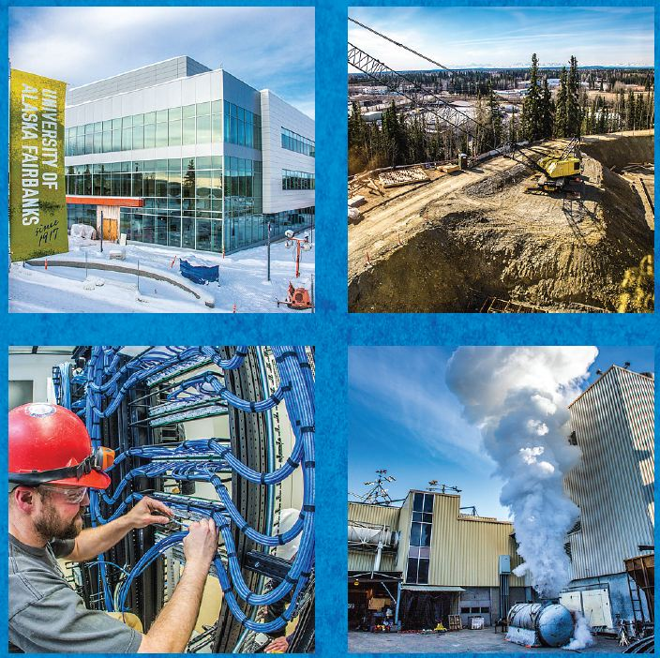
FY15 Capital Budget request

Slide 27
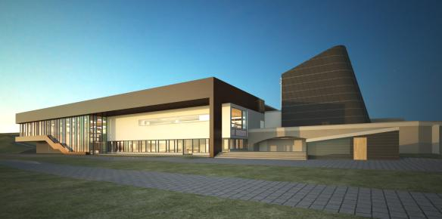
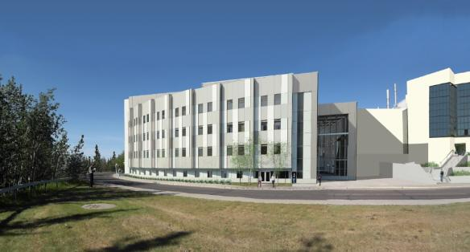
Breaking ground
Wood Center P-3
34,000 square-foot expansion project
Fall 2014
College of Engineering & Mines
120,000 square-foot modern classroom & lab space for engineering & research programs

Slide 28
Deferred maintenance and R&R completion status
FY09-FY13: 84% of projects complete to date
Fiscal Year | State Funding | # of Projects | % Complete
FY09 | $26.1 M | 7 | 100%
FY10 | $ 2.1 M | 3 | 99%
FY11 | $23.8 M | 10 | 100%
FY12 | $23.4 M | 16 | 87%
FY13 | $23.5 M | 12 | 48%
FY14 | $17.4 M | 14 | new

Slide 29
FY15 Capital Budget overview
Deferred Maintenance / R&R: $23M
Cogen Heating Plant upgrades
Critical electrical distribution
Fairbanks campus main waste lines, roof replacement
West Ridge facilities
ADA code compliance; elevators & alarms
Lower campus backfill
Patty Center revitalization
Campus infrastructure
Tilly Commons demolition
Wood Center student services renewal
Kuskokwim Campus voc-tech renewal

Slide 30
FY15 Capital Budget overview
Engineering Completion: $33.3M / $10.0M (cash/UA bond)
partnering with UAA for final phase
Cogen Heating & Power Plant: $200M / $45M (GO/UA bond)
Planning (future construction): $2.6M
Univ. Fire Dept Emergency Services & Management: $700k
CTC Emergency Services Training Center: $900k
P-3 Parking Garage: $350k
Kuskokwim Consortium Learning Center: $700k
Facility acquisition
Bunnell House replacement: $250k
Northwest Campus realignment: $150k

Slide 31
FY15 Capital Budget overview
Academic equipment & technology: $5.97M / $1.2M NGF
eLearning technology; wireless connectivity
Advanced analytical instrumentation; energy R&D
Mat-Su test kitchen / outreach center
IAC/CTC welding equipment, library digitization
Research for Alaska: $11.9M / $45.0M NGF
Opportunity investments $3.0M / $3.0M NGF
Community partnership self-reliance $1.0M
Earthquake prediction & monitoring $5.0M / $40.0M NGF
Arctic Oil Spill Response $1.0M / $2.0M NGF
Mapping Alaska $1.9M

Slide 32
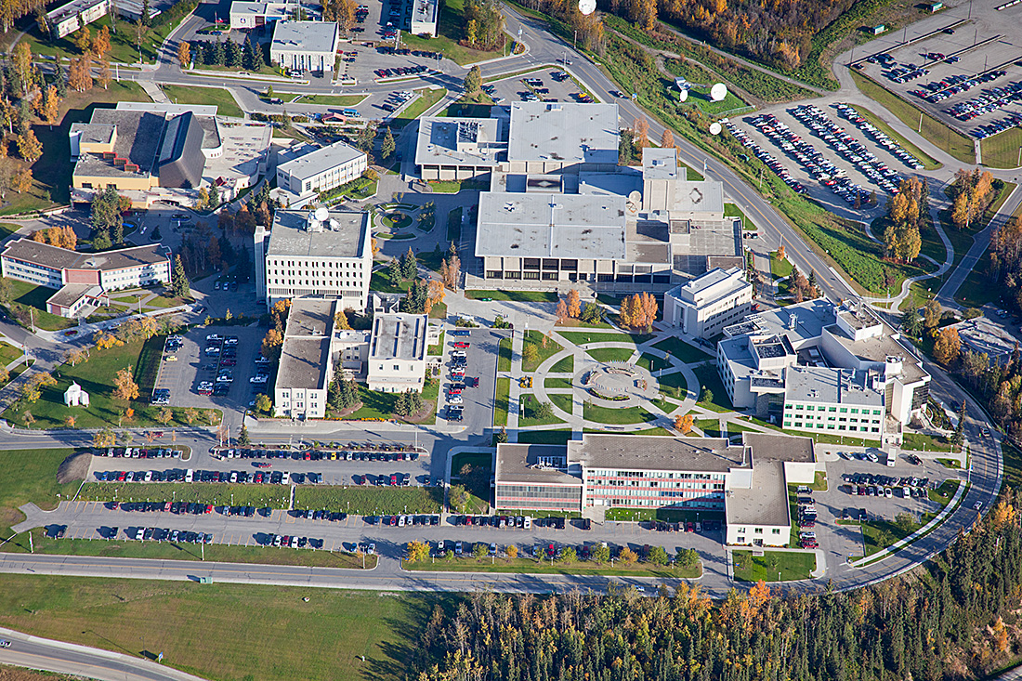
For Alaska’s future

Slide 33
Campus energy is the foundation
3.1 million square-feet of academic, research, office & housing space
Average age of buildings: 34 years
More than 170,000 square feet coming online by 2015
All these things need heat & power

Slide 34
Current Combined Heat & Power plant

Slide 35
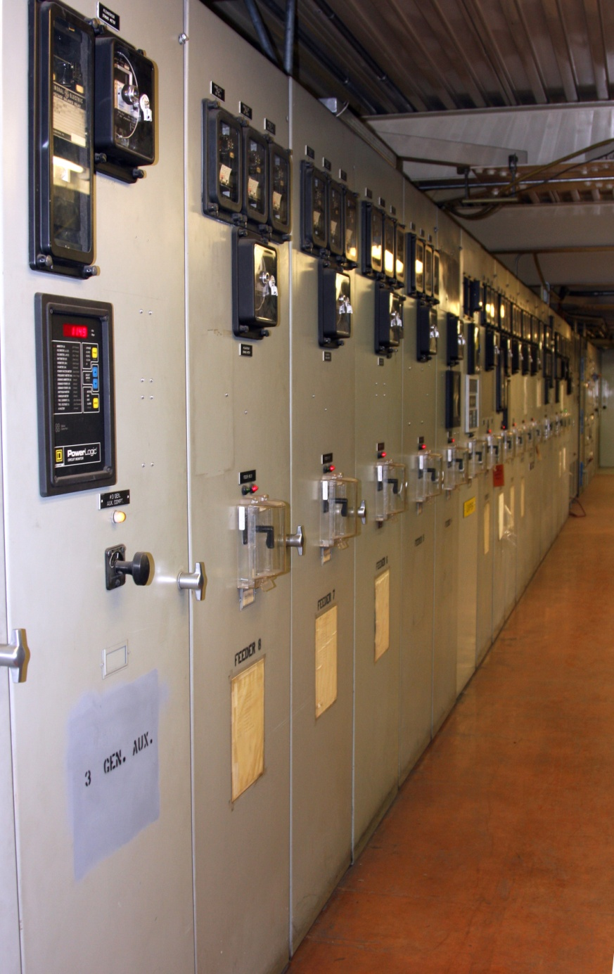
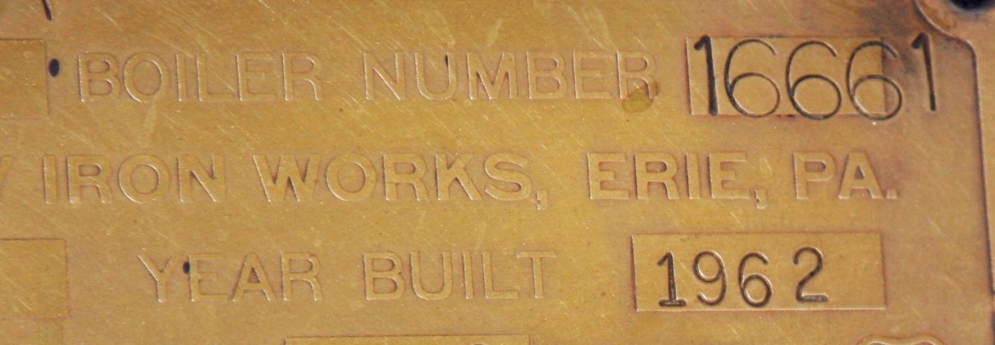
Atkinson plant
Two coal boilers (1964)
One oil boiler (1970)
One oil or gas boiler (1987)
Creates
Steam: to heat campus
Runs turbines
to create
Electricity
We also have:
10 megawatt diesel generator
Electrical distribution system

Slide 36
Key considerations
Risk of catastrophic failure (current plant’s 50-year lifespan is nearing)
Environmental responsibility
Regulatory climate
Political reality in Alaska & the nation
Alaska’s uncertain energy future
The economics for UAF, our programs & students
Responsible stewardship of state funds

Slide 37
Why not buy power from GVEA?
We need electricity & heat
The current electrical grid cannot supply both our power & heat needs at a reasonable price
GVEA can provide us electricity for lights & equipment, but that does not heat the campus
So, closing our plant is NOT a viable option

Slide 38
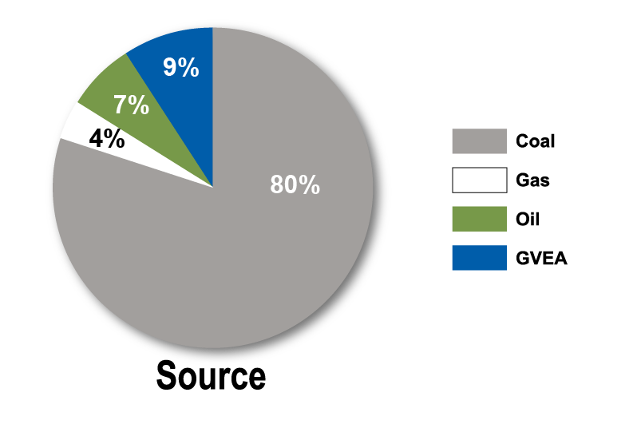
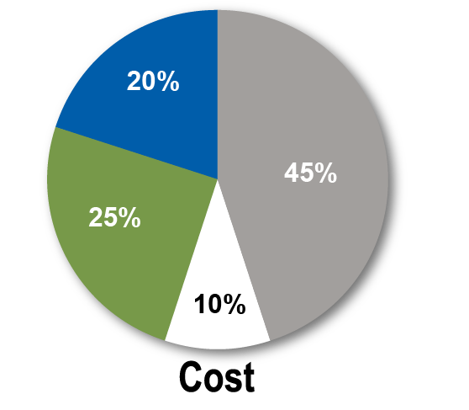
Fairbanks Campus energy sources
$9.8 million annual fuel cost (2012)
71,000 tons of coal
678,000 gallons of oil
51 million cubic feet of natural gas

Slide 39
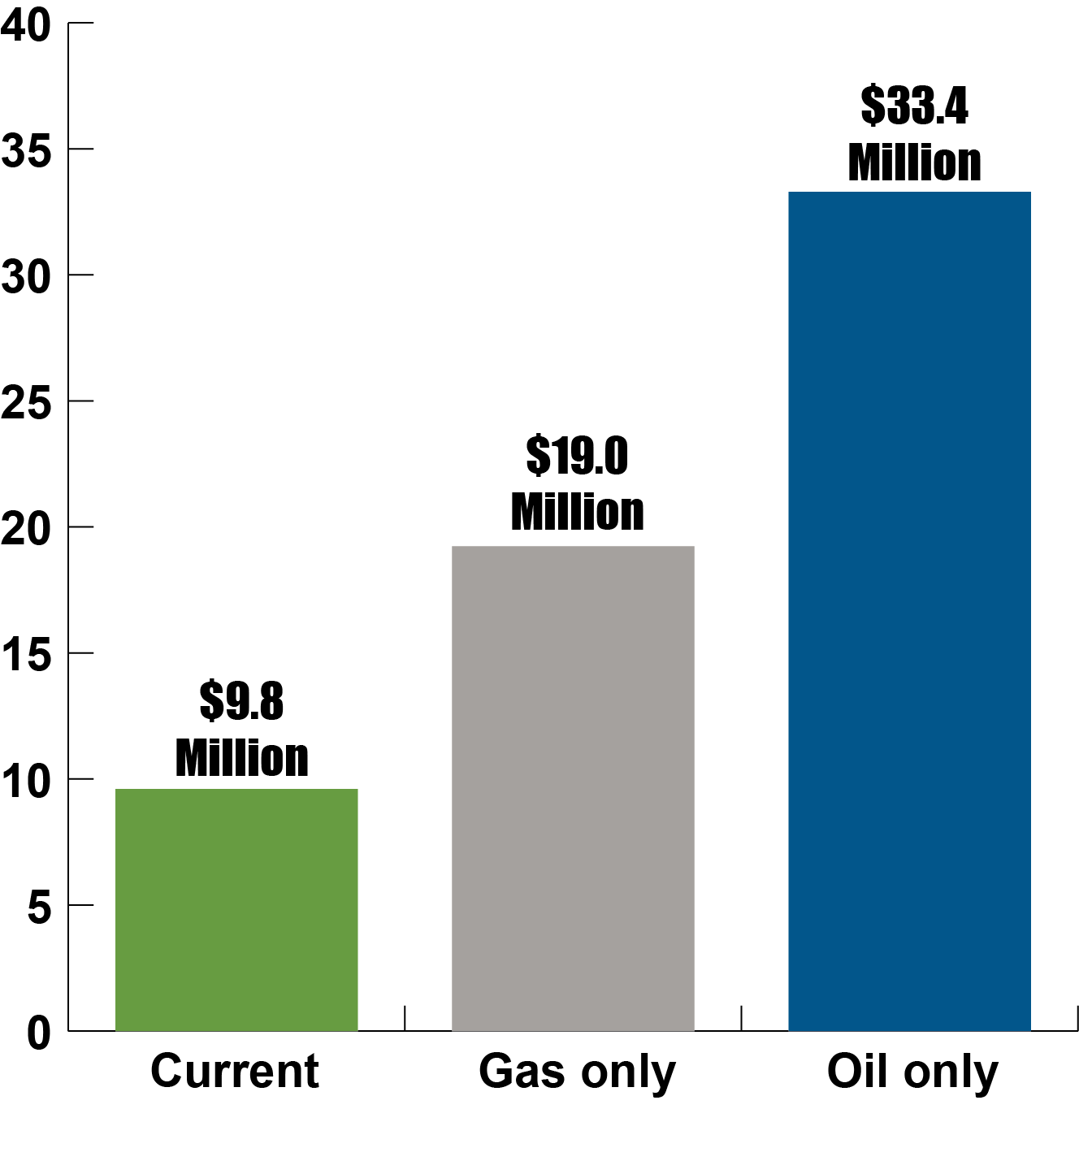
What if the main boilers fail?
Enormous increase in fuel costs that can harm:
The programs we provide
The research we do
The students we serve
And gas is available only in interruptible supply

Slide 40
A diversified energy portfolio Flexible, sustainable, fiscally responsible
Anchored by a new 17 megawatt circulating fluidized bed (CFB) boiler
Flexible solid fuel
Coal with up to 15 percent biomass
Replace oil boilers with gas or propane
Purchase renewable energy, when available
Energy conservation on campus
Renewable projects on campus (solar)

Slide 41
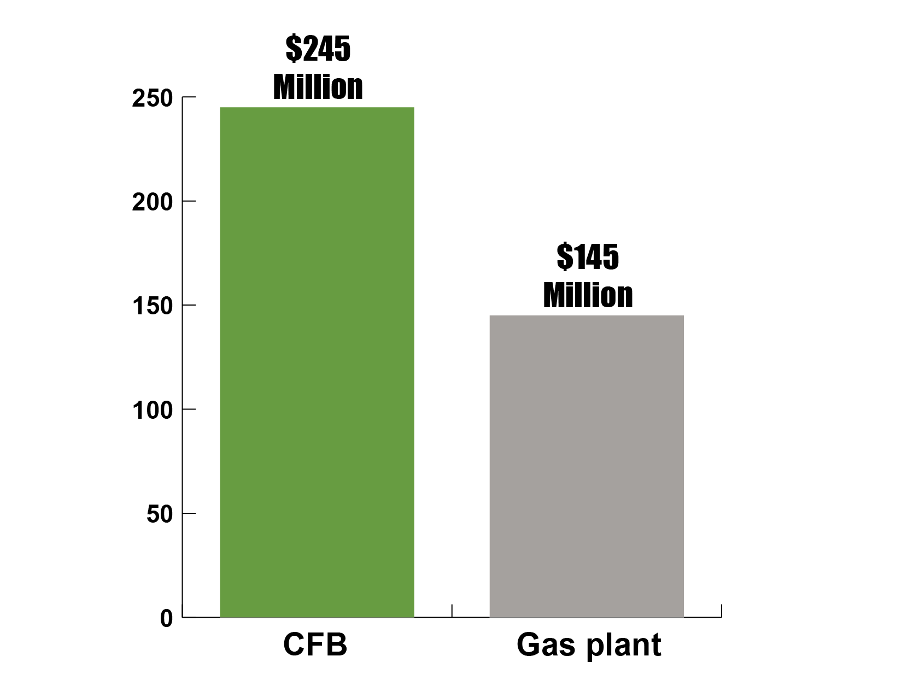
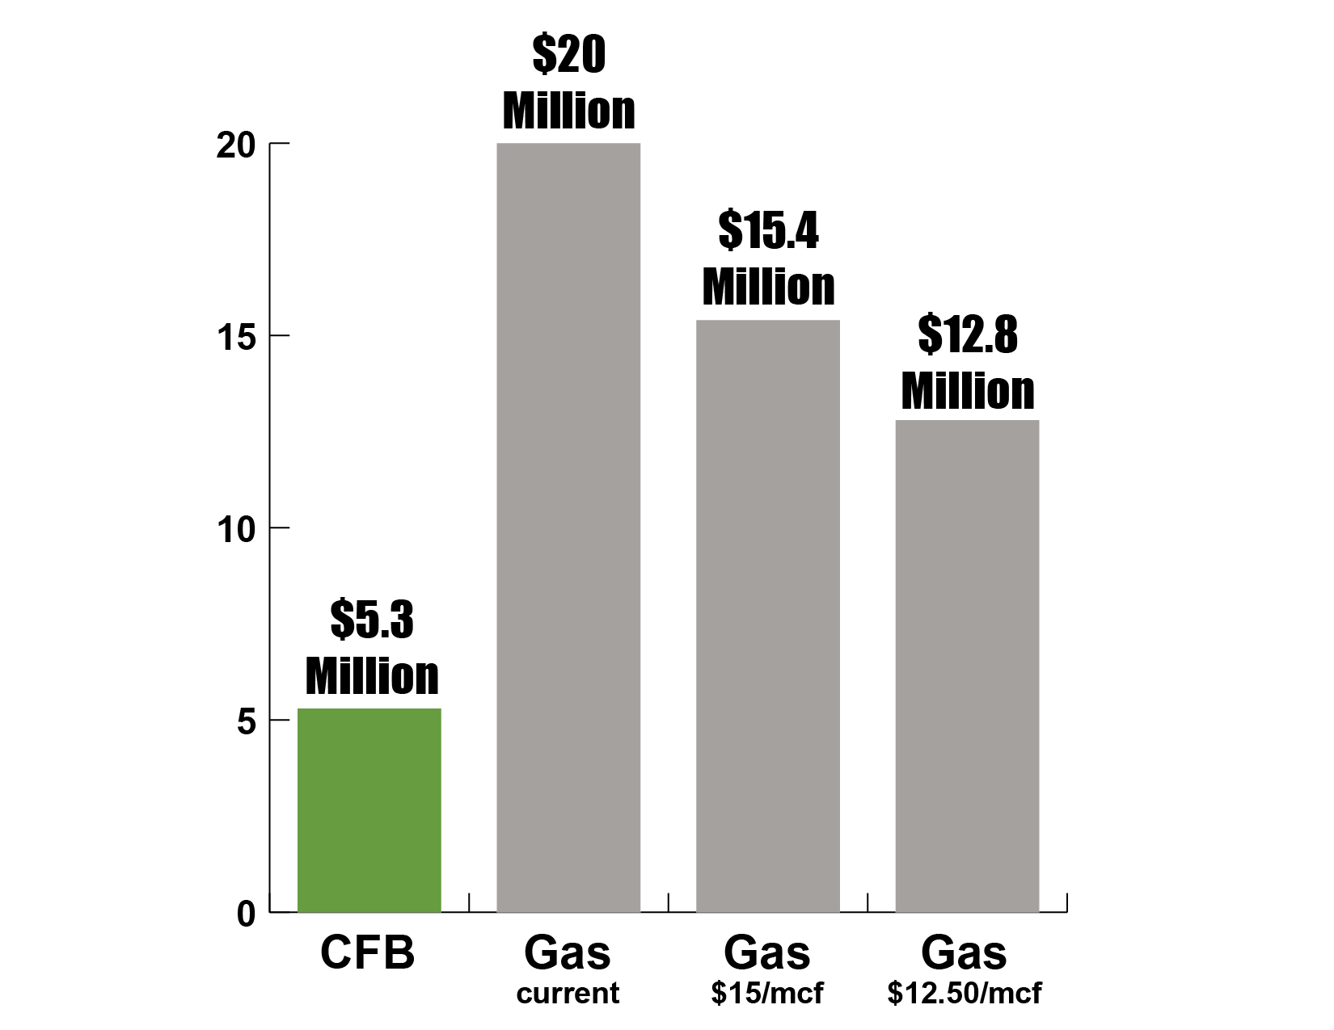
What about gas?
Capital cost
Fuel cost
$120
Million
Fairbanks does not have natural gas - yet

Slide 42
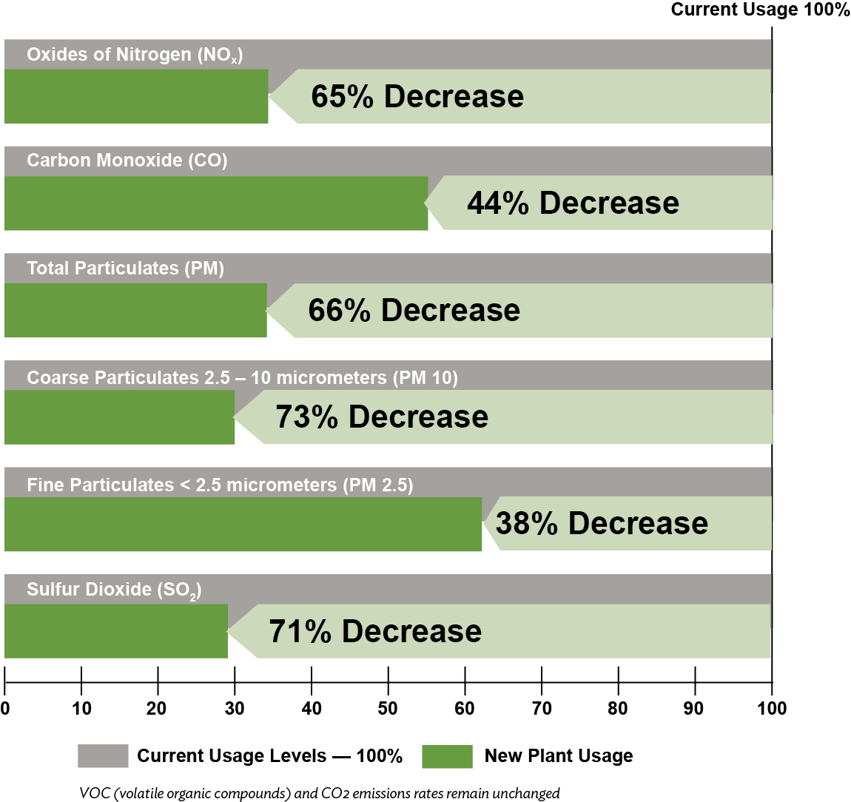
The new plant will reduce emissions

Slide 43
Project schedule
Completed
Preliminary design & cost estimate
Independent review of cost estimate
Preparation/submittal of air quality permit
This fiscal year
Permit process completed
P-3 possibilities explored, decision made
Total project cost and alternatives presented to Board of Regents, Governor, Legislature

Slide 44
Ideal project schedule
FY14
Procurement of boiler (engineering cost)
Selection of CM@R or P-3 contractor
FY15
Procurement of major equipment
Balance of plant design
Building & utility relocation
Foundation beginning spring 2015

Slide 45
Ideal project schedule
FY16-FY17
Construction
Commissioning August 2018
Risks / challenges
Air quality permit approval / challenges
Natural gas alternative
Legislative / community support
GO bond timing / passage
Construction cost overruns

Slide 46
Closing thoughts
Strategic direction requires strategic investment
UA / UAF can help the state through budget challenges
We need to make the case for strategic investment in higher education & research

