Slide 1
UAF Outdoor
Education Center
(naming opportunity)
Outdoor Adventures Program
William R. Wood Student Center
Where Adventure and Education
Meet
A Student Initiative of ASUAF and UAF Student Services
DRAFT
Notes:
Thank you for the opportunity to tell you about a few of the exciting things happening at UAF!

Slide 2
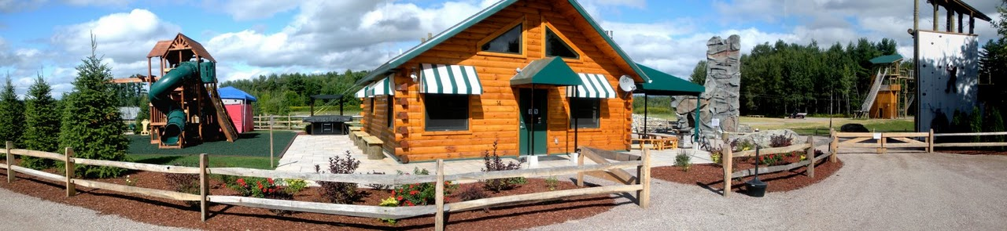
UAF Outdoor Education Center
Learning. Education. Adventure.
Year round.
Photos courtesy of Northern Lights Rock & Ice, Vermont

Slide 3
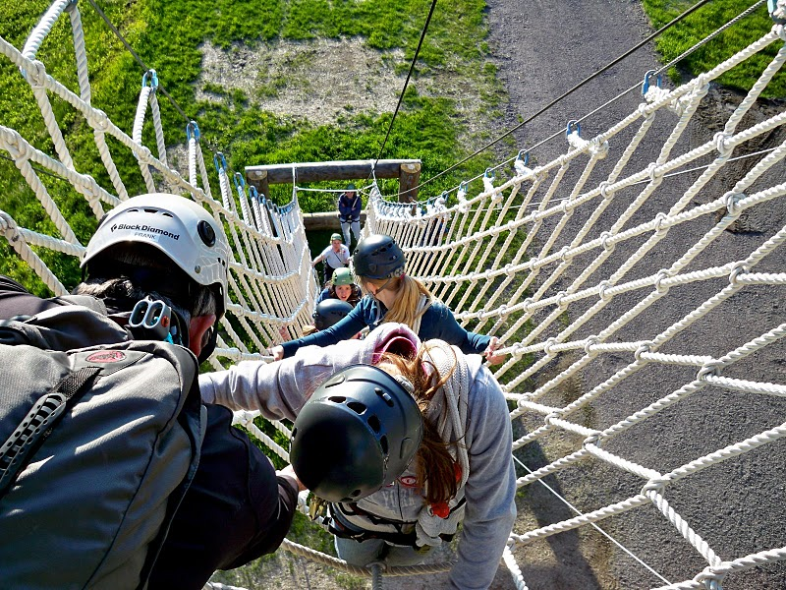
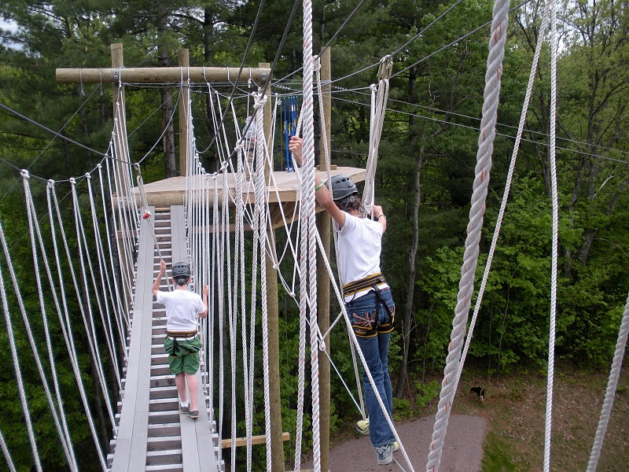
Ridge Top Ropes Course
Skill Development
Photos courtesy of Northern Lights Rock & Ice, Vermont

Slide 4
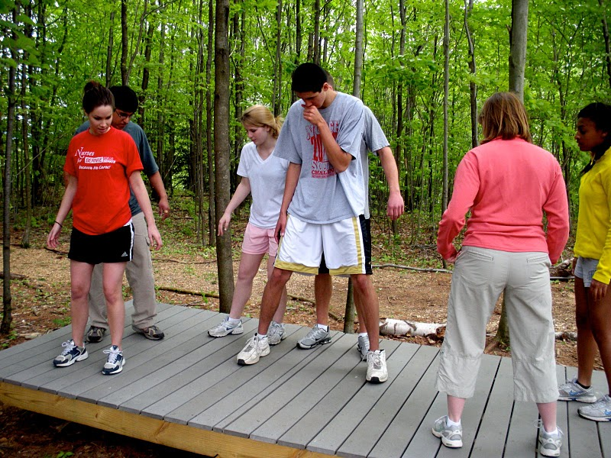
Problem Solving & Team Building
Photos courtesy of Northern Lights Rock & Ice, Vermont

Slide 5
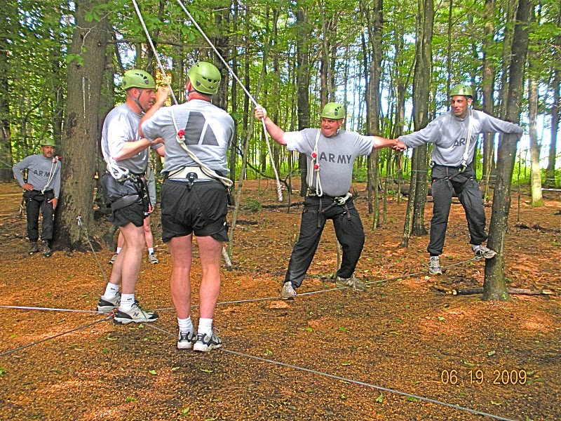
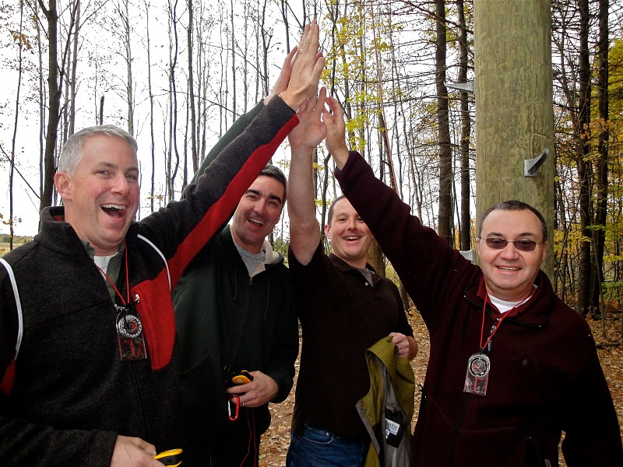
Corporate Team Development
Photos courtesy of Northern Lights Rock & Ice, Vermont

Slide 6
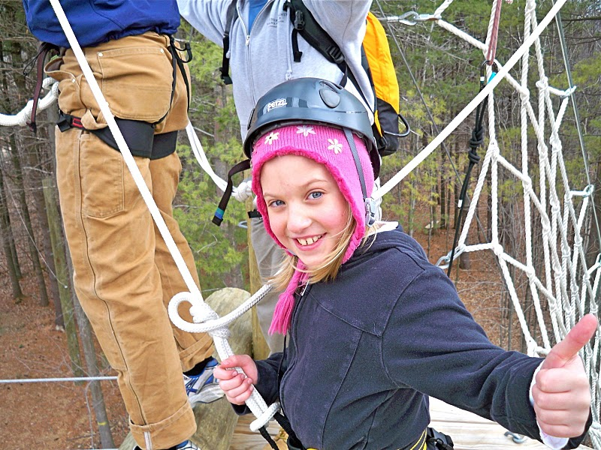
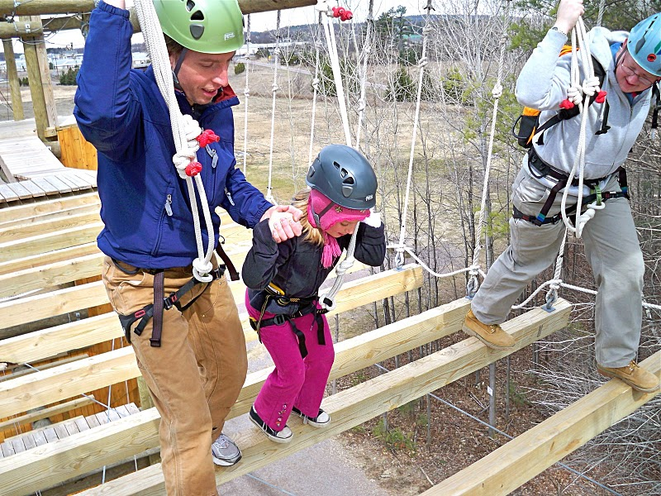
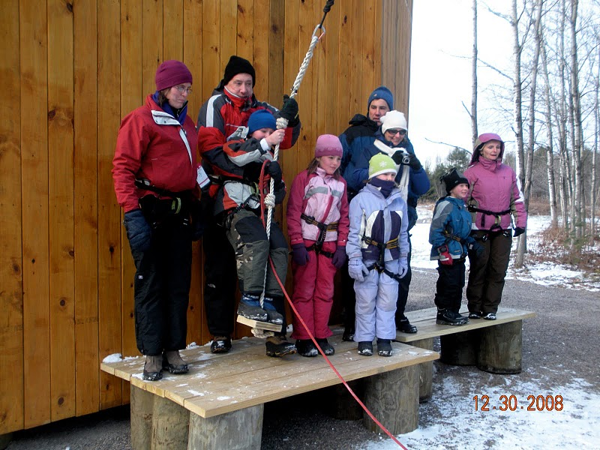
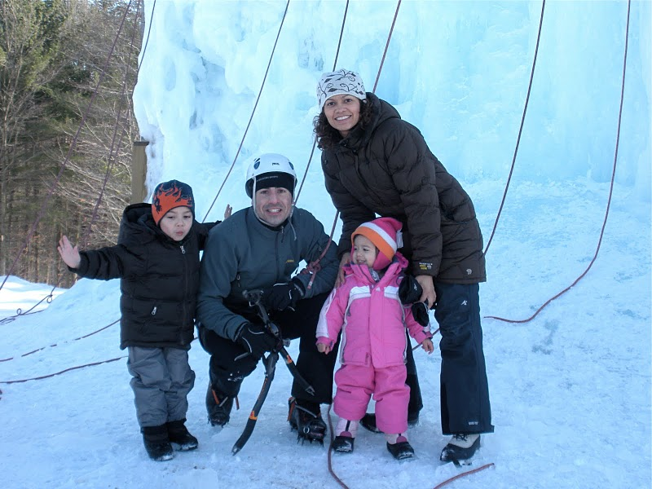
Family Fun
Photos courtesy of Northern Lights Rock & Ice, Vermont

Slide 7
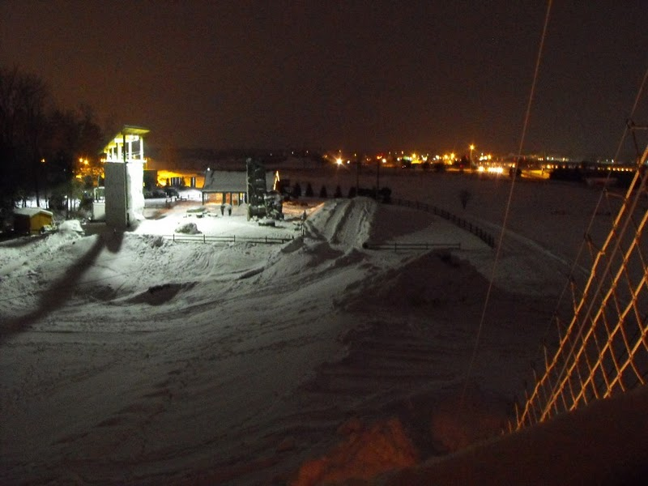
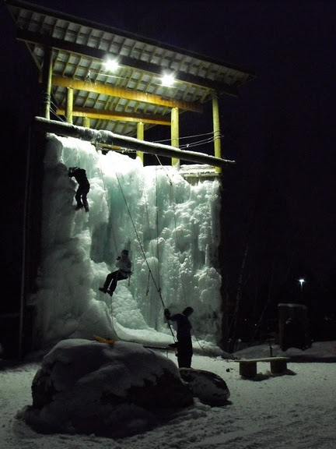
It’s Dark, It’s Cold, It’s Cool
Photos courtesy of Northern Lights Rock & Ice, Vermont

Slide 8
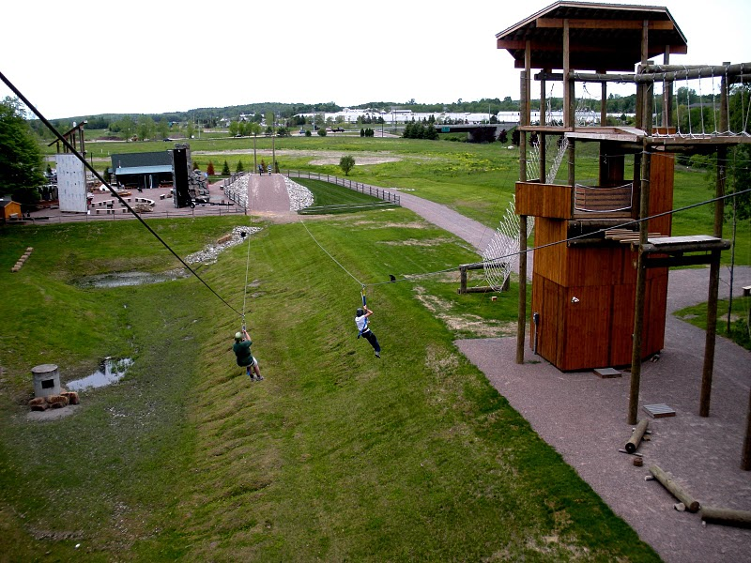
Zip Lines & Confidence Courses
Photos courtesy of Northern Lights Rock & Ice, Vermont

Slide 9
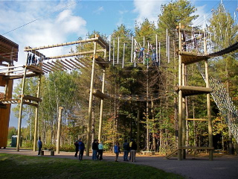
Nenana Ropes Course
Photos courtesy of Northern Lights Rock & Ice, Vermont

Slide 10
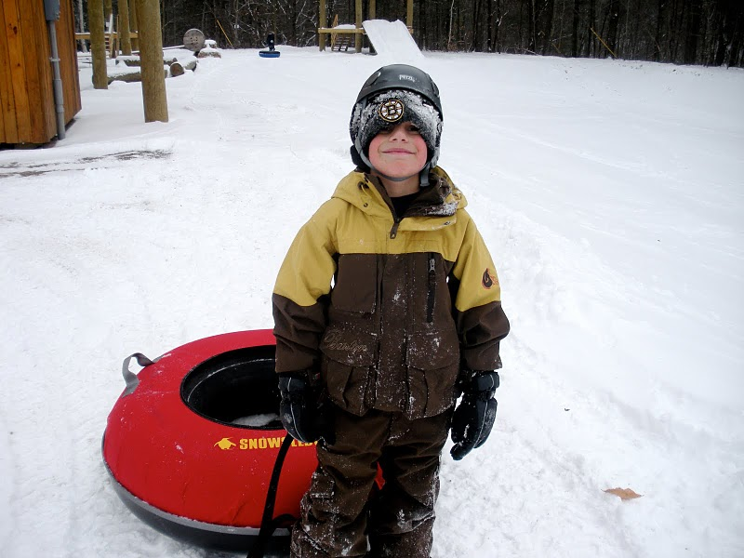
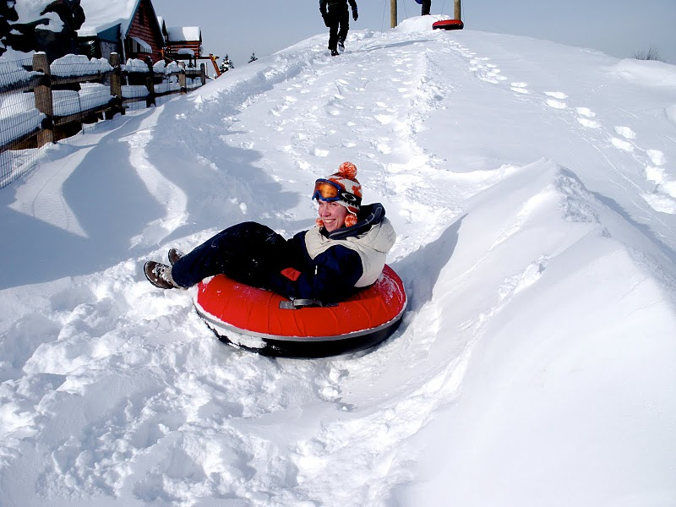
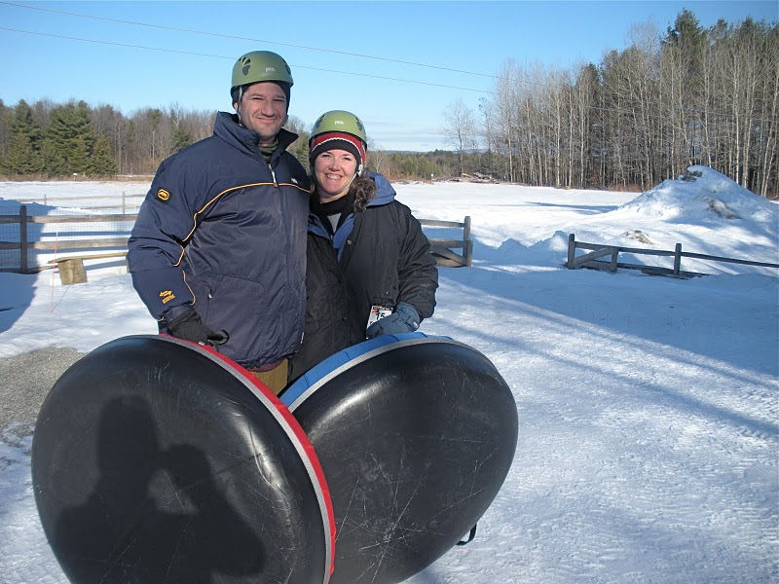
Tundra Tubing
Photos courtesy of Northern Lights Rock & Ice, Vermont

Slide 11
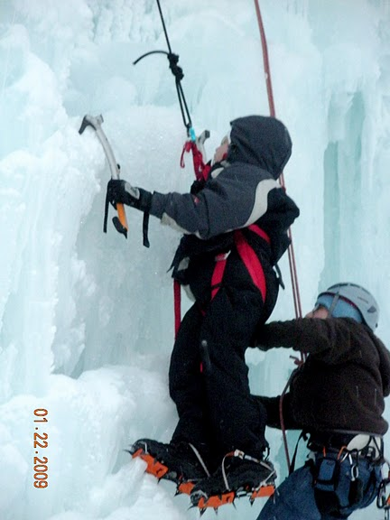
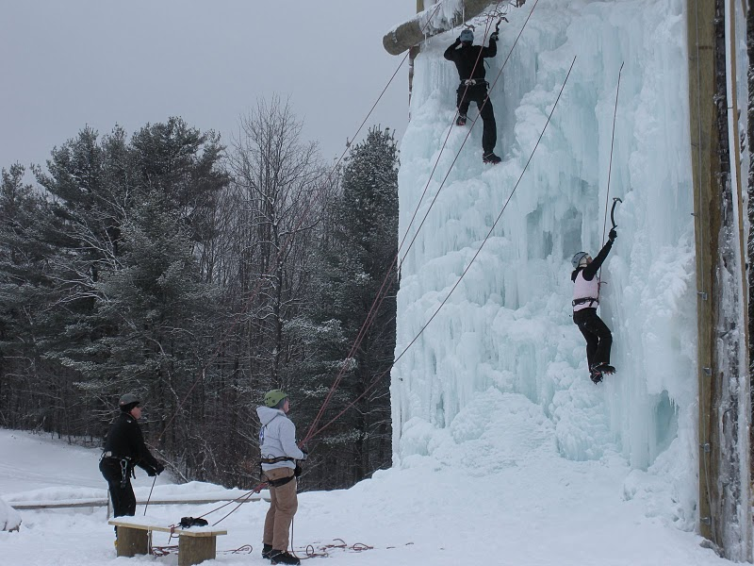
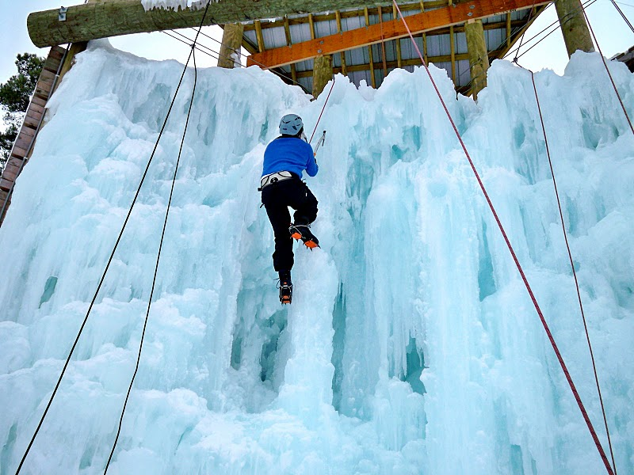
Denali Ice Wall
Photos courtesy of Northern Lights Rock & Ice, Vermont

Slide 12
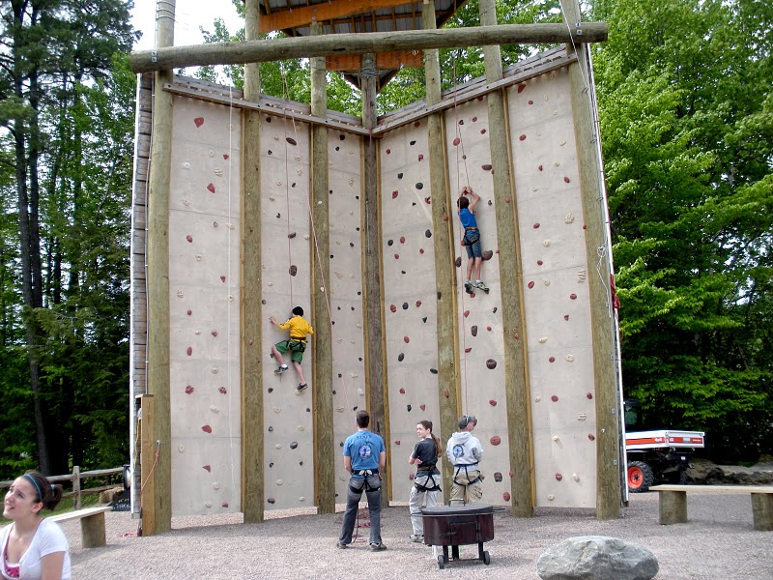
Summit Climbing Wall
Photos courtesy of Northern Lights Rock & Ice, Vermont

Slide 13
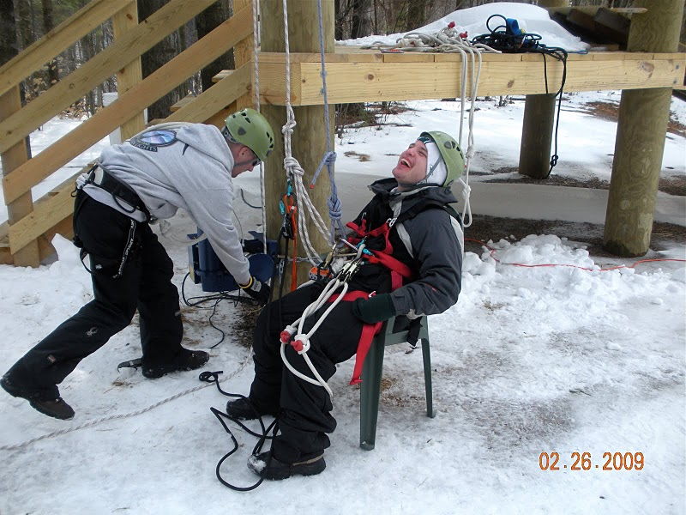
Special Needs – Special Programs
Photos courtesy of Northern Lights Rock & Ice, Vermont

Slide 14
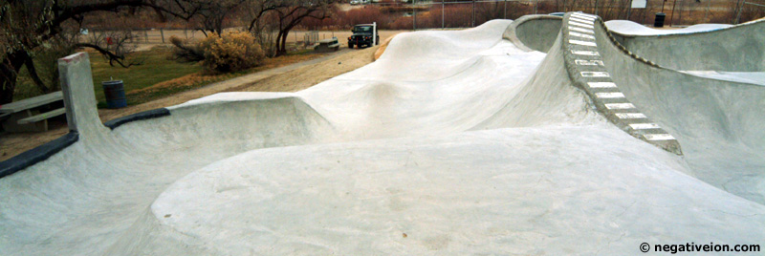
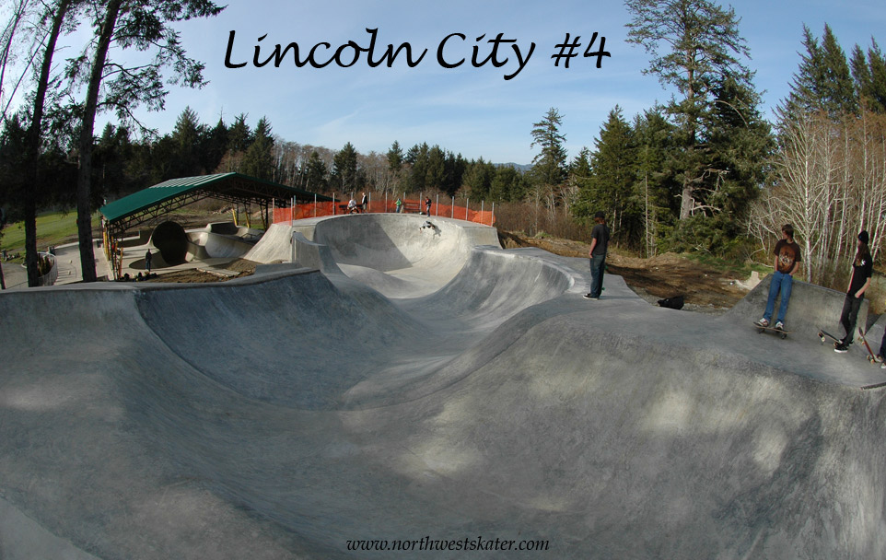
UAF Tanana Skate Board Park

Slide 15
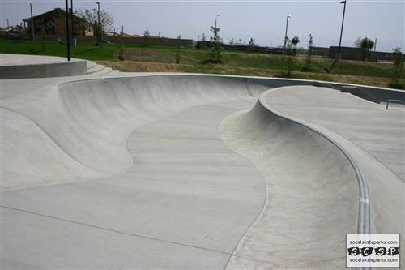
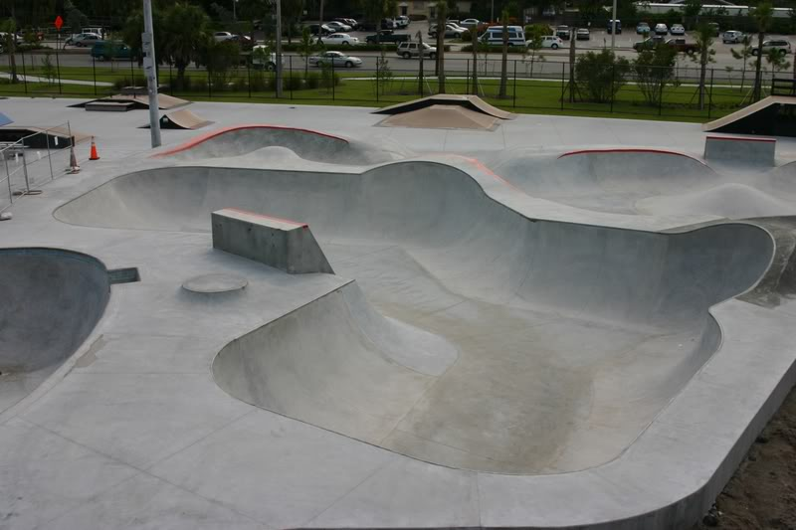
UAF Summit Skate Board Park

Slide 16
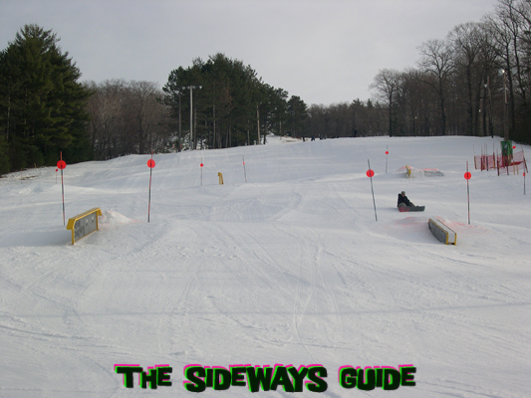
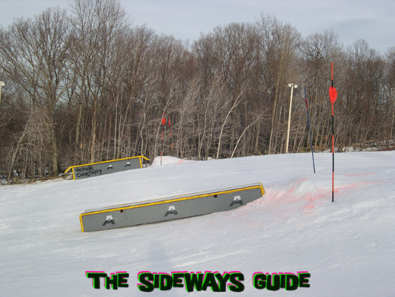
Nanook Terrain Park

Slide 17
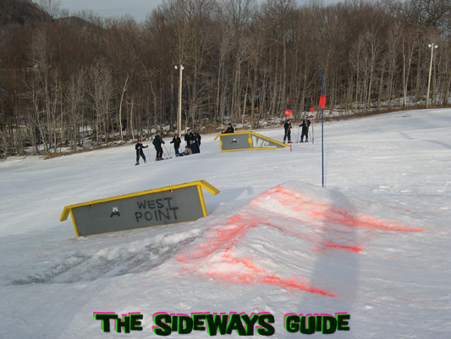
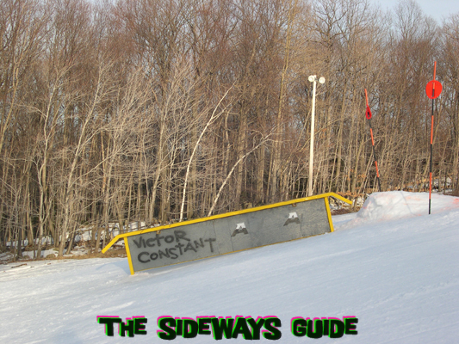
Nanook Terrain Park

Slide 18
Wood Center
Outdoor Education Center
Programs and Activities
Outdoor Adventures Series Residence Life
LIVE Program and Training Student Orientation
Summer Adventure Camps* Summer Sessions*
Upward Bound, RAHI, ASRA Staff Development*
PE Classes and Programs Athletics
School Programs (fall, spring)* Corporate Team Building*
Community Groups* ROTC Leadership

Slide 19
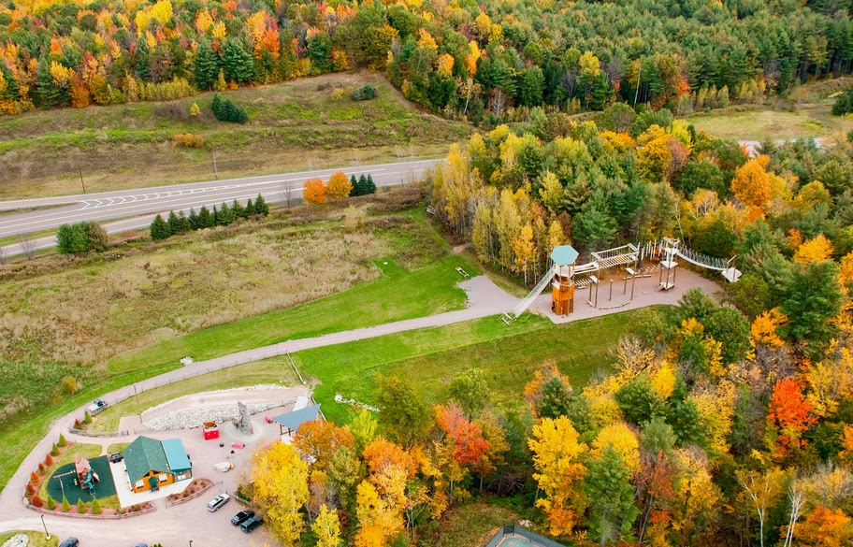
UAF Outdoor Education Center
Imagine the Possibilities!
ASUAF and UAF Student Services
Photos courtesy of Northern Lights Rock & Ice, Vermont

