Slide 1
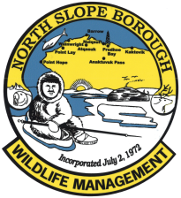
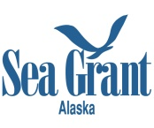
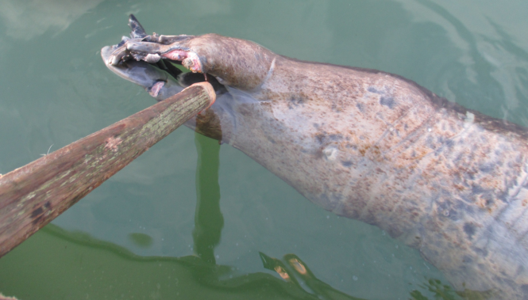
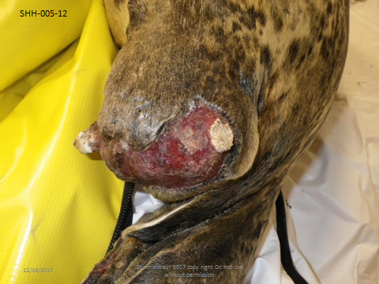
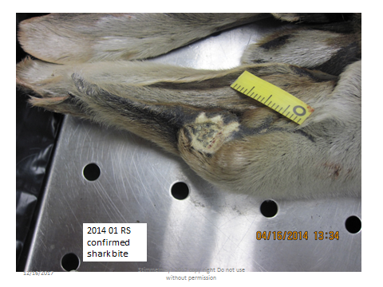
Sharks and Shark predation on Ice Seals and Sea Lions:
Preliminary results from the Bering Strait and the North Slope regions, Alaska
Raphaela Stimmelmayr¹, Gay Sheffield^{2,} Brandon Ahmasuk³, and Vicky Beaver⁴
¹North Slope Borough Department of Wildlife Management, Barrow, AK, Contact: raphaela.stimmelmayr @north-slope.org
² UAF Alaska Sea Grant/Marine Advisory Program, Nome, AK, ³Kawerak Inc. ; ⁴Ocean Associates, Inc.
Documentation of sharks within the Bering Strait region and along the North Slope Borough coastline is limited. We report on historic and recent stranding data, aerial survey sightings, and bycatch of cold adapted sharks such as Pacific sleeper shark (Somniosus pacificus) and salmon shark (Lamna ditropis) in the Bering Strait, Chukchi Sea, and Beaufort Sea regions. Additionally we present preliminary forensic evidence of shark inflicted wounds (e.g. flipper amputations, skin lacerations, circular bite wounds etc.) in ice-associated seals.
Left: Rear flipper amputation in a subadult bearded seal.
Below: Rear flipper amputation on an adult spotted (A) and ringed seal (B).
SHH-012-15
Table 1. Shark sightings, strandings, and bycatch information for the North Slope and Bering Strait region, Alaska 1950-2017.
Year | Location | Comment
1950 | Wainwright | Shark seen from landfast ice, swam along ice edge, as large as an umiaq
1998 | Point Hope | Sleeper shark, 7ft shark found dead
2001 | Point Barrow | Shark seen, had a small fin on its back
2007 | Teller | Sleeper shark, dead stranded
2010 | Gambell | Large shark attacking sea lion
2011 | Point Lay | Shark, dead stranded
2013 | Ledyard Bay | Shark near shore, swishing tail movement
2014 | Lavrentiya (RU) | Salmon shark caught in gillnet
2014 | Shishmaref | Sleeper shark, harvested
2014 | Eulen (RU) | Salmon shark caught in gillnet
2017 | Gambell | Salmon shark caught in gillnet
2017 | Shishmaref | Sleeper shark, dead stranded
2017 | Cross Island | Sleeper shark swimming near shore leaving trail in sediment ; ~5 ft, swishing tail movement
A
B
Northern Shark / Pinniped Interactions
We speculate ocean temperature rise, reduced sea ice coverage, and associated movements of prey species (e.g. fish, marine mammals, etc.) are resulting in increased exposure of northern shark species to pinniped prey. Research on shark distribution, stock structure, and interaction with northern pinnipeds in northern and western Alaska is needed.
Acknowledgements: This study was funded in part by a Prescott grant to the North Slope Borough. All tissues were collected under NMFS Permit # 814-1899-00 or NMFS Permit # 17350-01. Many thanks to the community members from the North Slope Borough and the Bering Strait region who allow us to sample their harvest. Without you, these results would not be possible. Quyanaq and Igamsiqanaghhalek!

