Slide 1
Creating Speakers:
2) From Simple to Complex
Owennatekha (Brian Maracle)
A.N.L.R.I. Fairbanks
May 21-24, 2018

Slide 2
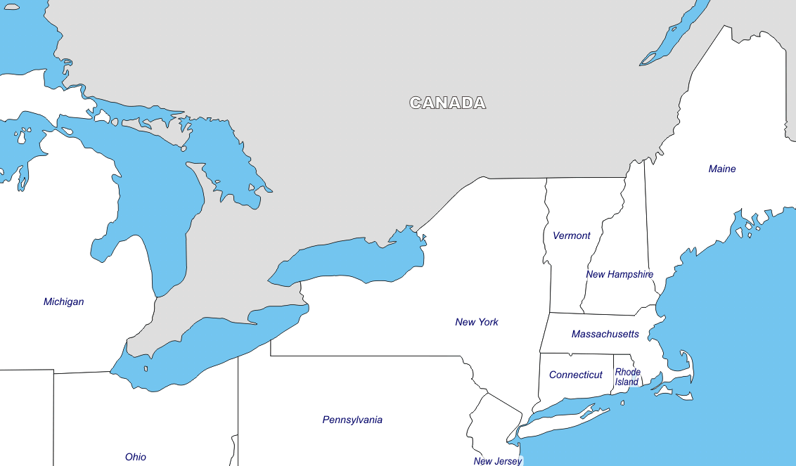
Montreal
*
Six Nations
*
Detroit
*
Boston
*
New
York
*

Slide 3
Six Nations
3 out of 6 languages still spoken
13,000 people living on-reserve
2 First-Language Mohawk speakers
(2,000 speakers live in the East)

Slide 4
Onkwawenna Kentyohkwa
(Our Language Society)
1999

Slide 5
* Adult Immersion Program (Year 1 & Year 2)
* On-Line Program
* Youtube: onkwawenna kentyohkwa
* web: www.onkwawenna.info

Slide 6
Four Presentations
#1 Root-Word Method
#2 Simple-to-Complex Curriculum
#3 Teaching Method
#4 Assessments & Goals

Slide 7
Admissions
Students do not require an extensive background in the language to attend
but anyone wanting to take our program must pass an admissions test.

Slide 8
We give prospective students the answers to the test because we want them to pass.

Slide 9
The “test” consists of 40 Mohawk words and the English meanings that they must memorize.

Slide 10
The words are 40 variations of the verb “to like.”
-nòn:we’s

Slide 11
kenòn:we’s = I like it. wakenòn:we’s = It likes me.
senòn:we’s = You like it. sanòn:we’s = It likes you.
ranòn:we’s = He likes it. ronòn:we’s = It likes him.
yenòn:we’s = She likes it. yakonòn:we’s = It likes her.
konnòn:we’s = I like you.
takenòn:we’s = You like me.
rinòn:we’s = I like him.
rakenòn:we’s = He likes me.
+ 28 more

Slide 12
The words on the test are the 40 most common bound pronouns used to construct words.
(There are 21 more.)

Slide 13
The 40 words tests memory and commitment.
Passing the test does not predict success.

Slide 14
The Curriculum:
From Simple-to-Complex

Slide 15
Short words are not necessarily simple.
Long words are not necessarily complex.

Slide 16
yénskewe’
yonkeni’serehtsherowá:nen

Slide 17
yénskewe’
I will arrive back there
yonkeni’serehtsherowá:nen
We (two) have a big car

Slide 18
y én s k ewe ’
6 elements
yonkeni ’serehtsher owá:nen
3 elements

Slide 19
And not everything that is simple
is easy to describe.

Slide 20
I went for a walk.

Slide 21
tewakathahahkwanónhne

Slide 22
tewakathahahkwanónhne
te wak at hah a hkw a hn onh ne
10 elements

Slide 23
At Onkwawenna,
we start with the simplest form of the language

Slide 24
We start by describing
the way someone or something
is.

Slide 25
We describe someone’s or something’s
state or condition.

Slide 26
I am …
You are …
He is ...
She is ...
It is ...
They are ...

Slide 27
I am standing.
You are listening.
He is married.
She is singing.
It is raining.
They are crazy.

Slide 28
Soon after learning simple descriptions in the present, students learn to express these states or conditions in the past and future.
wenhniserí:yo It is a nice day.
wenhniseriyóhne It was a nice day.
enwenhniseriyóhake It will be a nice day.

Slide 29
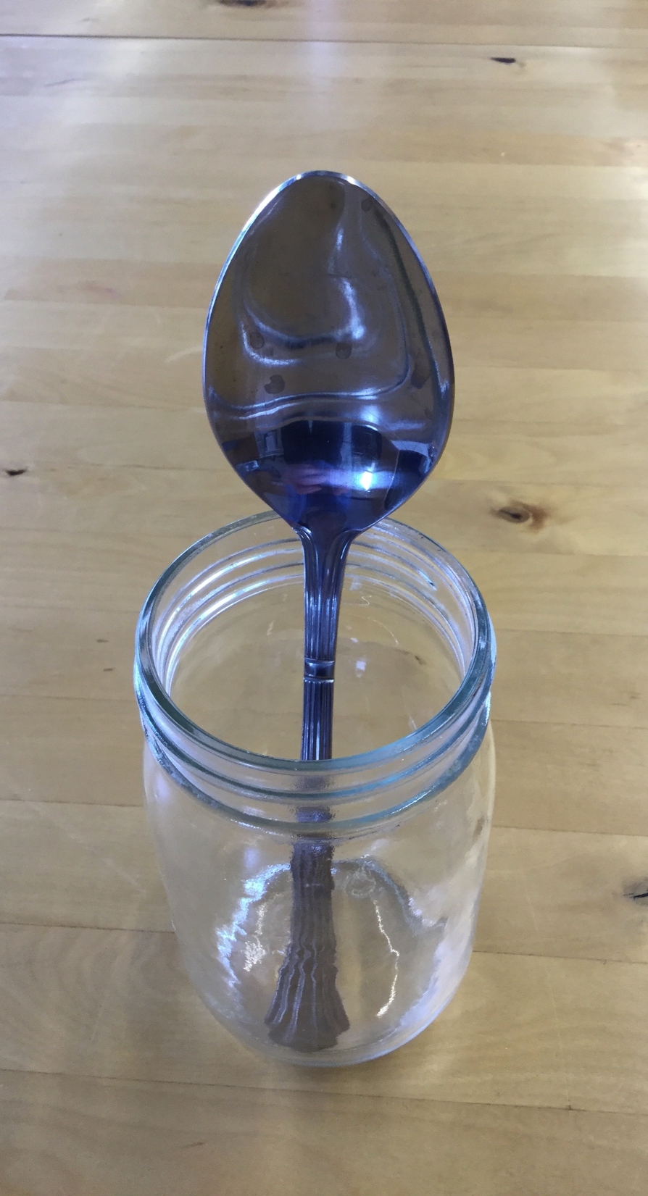
“Simple” descriptions
are what is needed
to describe a photograph.

Slide 30
Unit #1
Making Simple Conversations
Making statements, questions, answers
Using negatives, qualifiers, conjunctions
With just two verbs – to like & to know
Asking & Answering naming questions

Slide 31
Unit #1 Test
I know that you like that boy
but do you know if he likes you?
That young woman, the one named Kathy, doesn’t know if that old lady likes her more than you do.

Slide 32
Unit 2
Kinship
Negatives
Resemblance
Dead & Alive
Numbers
Age
Love & Hate

Slide 33
Unit 2 Test
Are you related to that good-looking young man named Paul?
Mary is 30 years older than her daughter Betty but they still look alike.

Slide 34
Unit 3
Describing the way things used to be
Being engaged, married, divorced
When something was the case
Being in a state/condition again
Good people, bad people
Having kids, animals, families

Slide 35
Unit 3 Test
My wife and I aren’t married but we have ten kids.
My nephew is a bad kid but I don’t hate him.

Slide 36
Unit 4
Times of the day & year
Names of days and months
Asking and telling time
Being here & there: past, present, future
Place names

Slide 37
Unit 4 Test
You don’t have to be here on Tuesday next week.
Didn’t your parents used to live in Toronto?
Where did you live when you before you were married?

Slide 38
Unit 5
70 physical, mental & emotional state verbs:
angry, awake, busy, crying, dark-skinned, drunk, eating, famous, fat, funny, happy, hungry, lazy, lucky, nasty, poor, pregnant, sad, short, sleeping, smart, worried, working

Slide 39
Unit 5 Test
She won’t be happy until she is thinner.
He was always drunk when he was single.
It’s surprising that she isn’t married yet.

Slide 40
Unit 6
How action verbs are constructed
30 active verbs:
asking, cooking, defecating, eating, getting up, helping, listening, looking, raining, resting, saying, sleeping, snowing, studying, telling, waking up, washing, watching, working

Slide 41
Unit 6 Test
Don’t wash the car. It’s going to rain.
You didn’t ask me. You told me!
The old man always falls asleep after he eats.

Slide 42
Unit 7
20 more complicated action verbs

Slide 43
Unit 8
70 personal possessions:
book, car, gun, house, job, money, shoes
15 common verbs used with possessions:
buying, getting, giving, trading, using, washing
25 personal possession characteristics:
big, cheap, colour, dirty, expensive, good, long, new, pretty, small, soft, ugly, wet

Slide 44
Unit 8 Test
Who washed this blanket? It’s still dirty.
The red wire is often dangerous.
The yellow car is too old and ugly for him to sell. No one will buy it.

Slide 45
Unit 9
20 original food names & roots:
beans, corn, fish, fruit, potatoes, meat, water
60 “new” food names:
banana, beer, cake, pizza, spaghetti
5 action verbs used with food:
cooking, eating, liking, making
20 food characteristics:
baked, burnt, frozen, mouldy, salty, sweet

Slide 46
Unit 9 Test
I hate hard butter.
This apple is not sweet.
Carrots are not fattening.
My neighbour’s son eats too much candy.

Slide 47
Unit 10
40 “outside” nouns & roots:
cloud, fence, garden, hill, rapids, town, tree
20 places in a house:
bathroom, couch, garage, kitchen, yard
30 places in relation to a house:
behind, in front, north of, this side of

Slide 48
Unit 10 Test
Why is your son lying in the mud?
She’s running on the other side of the road.
Is your car on the left or right side of the fence?

Slide 49
Unit 11
60 body part nouns and roots:
arm, blood, eye, hair, nose, thumb, tooth
10 action verbs used with body parts:
bite, sniff, bleed, hit, touch, grab, rub, scratch
20 sicknesses & ailments:
blind, cancer, deaf, diabetes, fever, flu, in pain

Slide 50
Unit 11 Test
Why is your tongue so dark?
I had a stomach ache yesterday and now I have a headache and a fever.
Chickens don’t have toothaches
because they don’t have teeth.

Slide 51
Unit 12
100 names of animals, birds, insects, fish, trees
25 weather terms in past, present and future

Slide 52
End of 1st Year Story
My parents were married for more than 50 years but they have both passed on. My father was a carpenter. They were both Mohawks but they didn’t speak or understand the language, just a couple of words. We lived in Buffalo
when I was a boy, until I was 12 years old.

Slide 53
My wife Audrey and I have been together for 21 years and we have been married for 16 years. We are very happy together and we love one another very much. We do not have have any children together but she has two children, a son and a daughter. Her son lives in the U.S. and her daughter lives on the ground floor in our house with her two boys. I have one daughter who lives next door to us with her boyfriend and her son.

Slide 54
Audrey and I lived in Anchorage for a short while about ten years ago. I was working at a radio station there. Both of us don’t like big cities very much but it was really nice being out on the land up here. I’m happy to be back in the North again.

Slide 55
The 1st Year is spent
learning how to describe states & conditions photographs.
The 2nd Year is spent
learning how to describe actions and events videos.

Slide 56
Mohawk verbs are very complex.
They usually are a whole sentence in English.
Remember
ensekhetsi’tsyahninonhsè:ra’
I will go buy flowers for her again.
?

Slide 57
A Mohawk verb can describe:
* an action
* who did it
* what they did the action with or to
* when they did it
* If action happened before or is happening again
* the direction the action is taking place
* if the action is being done to or for someone else

Slide 58
* if the action is taking place at the same time as something else is happening
* if the action happened or is happening multiple times
* if the action is reversing or undoing a previous action
* if the person performing the action is going or went someplace to do it

Slide 59
In 2nd Year, we begin teaching the simplest form
of the verb and then add prefixes and suffixes starting with the grammatically simplest one.
wa’kerhó:roke’ I covered s.t.

Slide 60
Unit 1
wa’kerhó:roke’ I covered s.t.
ya’kerhó:roke’ I covered s.t. there

Slide 61
Unit 2
wa’kerhó:roke’ I covered s.t.
takerhó:roke’ I covered s.t. here

Slide 62
Unit 3
wa’kerhó:roke’ I covered s.t.
sakerhó:roke’ I covered s.t. again

Slide 63
Unit 4
wa’kerhó:roke’ I covered s.t.
wa’kerhorókhon’ I covered s.t. many things

Slide 64
Unit 5
wa’kerhó:roke’ I covered s.t.
wa’kerhorókhsi’ I uncovered s.t.

Slide 65
Unit 6
wa’kerhó:roke’ I covered s.t.
wa’kherhó:rokhse’ I covered s.t. for her

Slide 66
Unit 7
wa’kerhó:roke’ I covered s.t.
wa’kerhorókhe’ I’m on my way to cover s.t.

Slide 67
yonsakenirhorokhsyón:ko’
shonkwarhorokhsyonkwennihrónhne

Slide 68
yonsakenirhorokhsyón:ko’
two females went there again to uncover many things
shonkwarhorokhsyonkwennihrónhne
He went to uncover many things for us

Slide 69
accordian

Slide 70
End of 2nd Year Story
They say that if you can boil water you can make maple syrup. That’s true, but there’s a big difference between good maple syrup and maple syrup that’s not so good. My wife Audrey and I make maple syrup every Spring. When it freezes at night and thaws during the day, the sap will run.
I drill a hole in a maple tree about two inches deep.

Slide 71
I put in a metal or plastic tap, hang a bucket on it and collect the sap every day. The sap is sweet and delicious. We make tea with it and we drink it as a medicine. I boil the sap in a big pan outdoors. I used to use wood to heat the pan but now I use propane. I boil the sap into syrup and Audrey bottles it inside the house. You have to boil 40 gallons of sap to get one gallon of syrup.

Slide 72
This year we made about 80 bottles.
We use only a couple bottles a year by ourselves and we give the rest of it away
to friends, family and visitors.
If you visit us at our home in Six Nations,
you will leave with a bottle.
So come pay us a visit!

Slide 73
Owennatekha (Brian Maracle)
owennatekha@gmail.com

